Slide 1
Model differentiation pathway of non-naïve CD8s in T1D subjects informed by ATACseq
10-17-24 SI meeting
Ty Bottorff – Bioinformatics postdoc
Linsley lab

Slide 2

Acknowledgements
Peter Linsley
Long lab
Josh Centore
Alice Wiedeman
Alice Long
Genomics core
Software team
Bioinformatics group
Stephan Pribitzer
Basilin Benson
ITN
John Ray
Patient donors

Slide 3
Outline
Introduction
T cell exhaustion
motivating data from previous work (T1DAL & TN10)
Results
epigenetic differences between different non-naïve CD8 populations in AbATE
complementary transcriptomic evidence from TN10
using MT SNV counts in AbATE to inform directionality in model differentiation pathways
Conclusion/next steps
Notes:
AbATE is recent onset (2 14 day courses of teplizumab 1 year apart), and TN10 is 14 day course of teplizumab to see if it would delay/prevent stage 3 T1D (clinical diagnosis) in those with high-risk (stage 2 T1D)
T1DAL trial of alefacept (LFA3-Ig fusion, binds CD2, disrupts CD58-mediated costimulation of T cells, selectively depletes memory/effector T cells) in recent-onset T1D patients

Slide 4
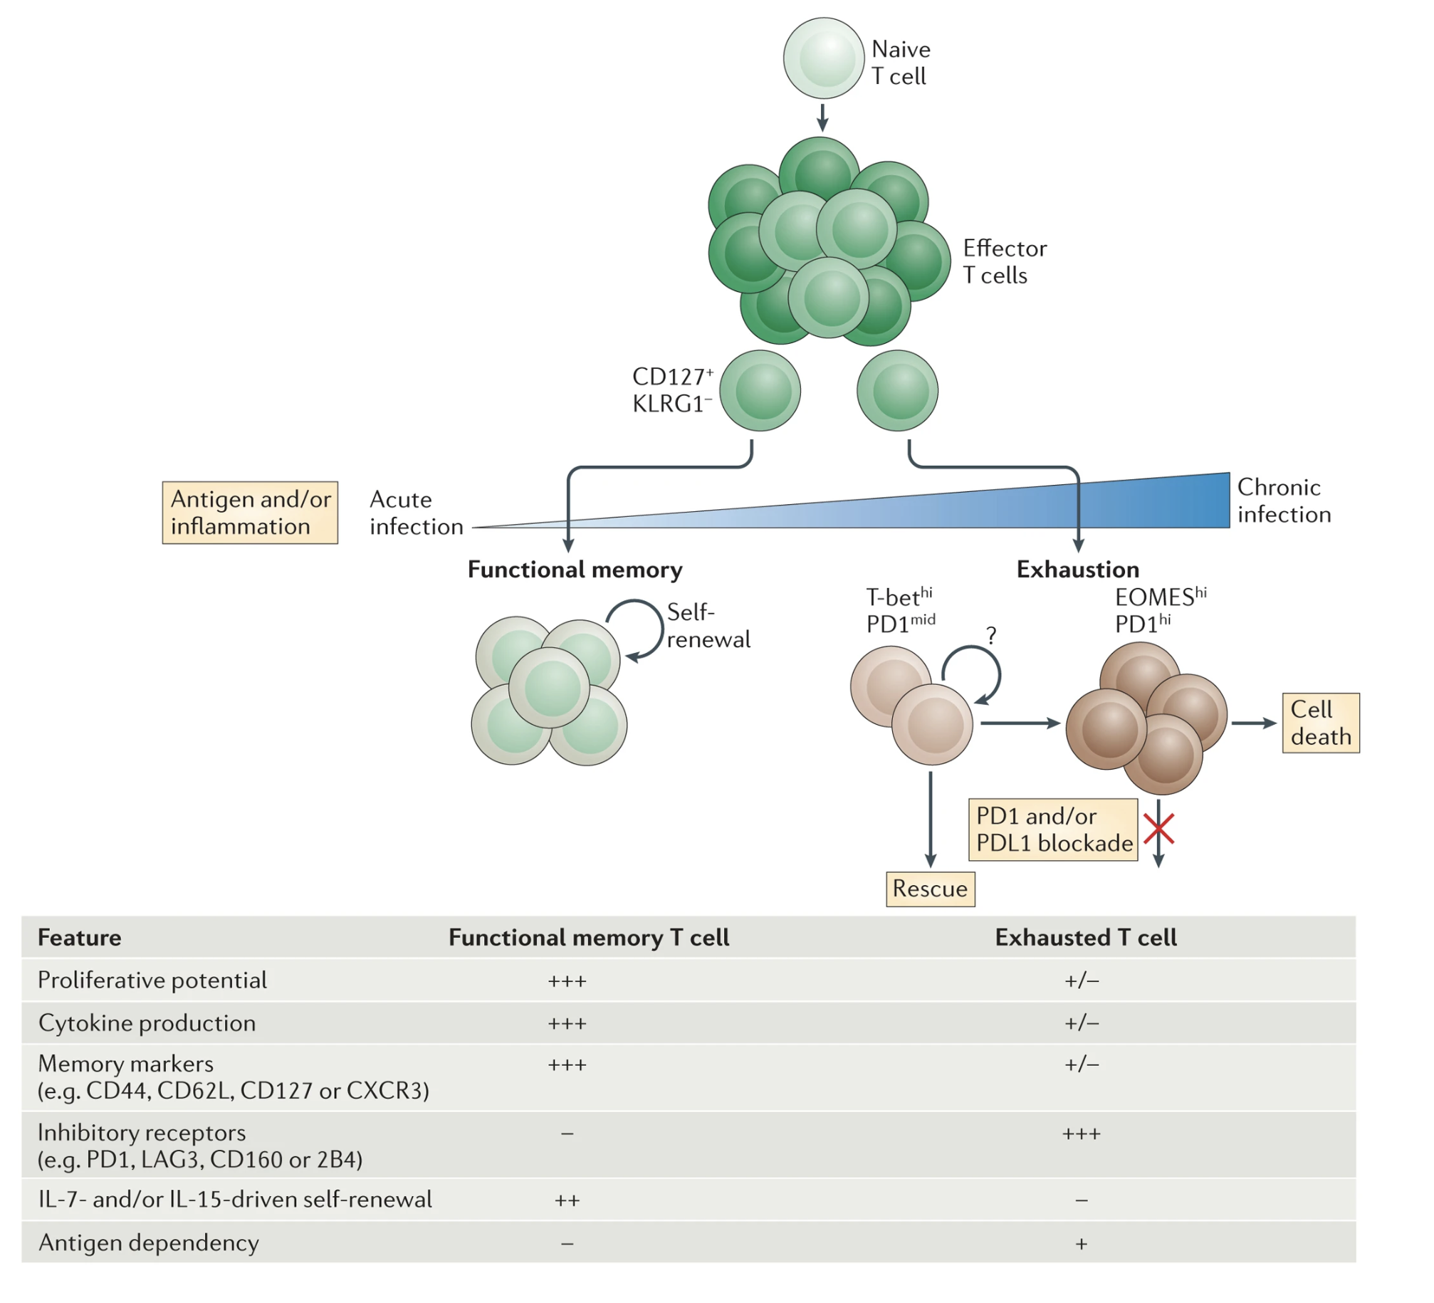
T cell exhaustion results from chronic antigen stimulation, inability to fully clear antigen
Wherry & Kurachi (2015). Nat Reviews Immunol
Notes:
T_{ex}
specific TFs (EOMES, TOX)
epigenetic changes

Slide 5
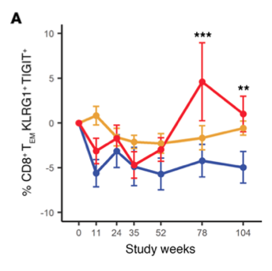
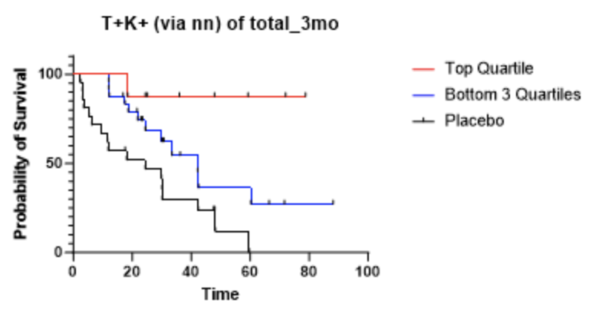
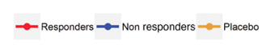
TIGIT⁺KLRG1⁺ (exhausted-like) non-naïve CD8 frequency positively associates with outcome in T1D
Diggins et al. (2021) JCI Insight
Joshua Centore
Notes:
high IR expression on T cells correlates with reduced autoimmune symptoms and responsiveness to anti-CD3 in T1D
This is T1DAL (alefacept, left) and TN10 (teplizumab, right)
T1DAL trial of alefacept (LFA3-Ig fusion, binds CD2, disrupts CD58-mediated costimulation of T cells, selectively depletes memory/effector T cells) in recent-onset T1D patients
AbATE is recent onset (2 14 day courses of teplizumab 1 year apart), and TN10 is 14 day course of teplizumab to see if it would delay/prevent stage 3 T1D (clinical diagnosis) in those with high-risk (stage 2 T1D)

Slide 6
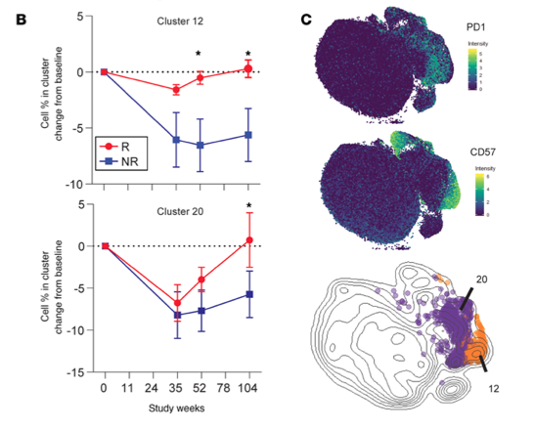
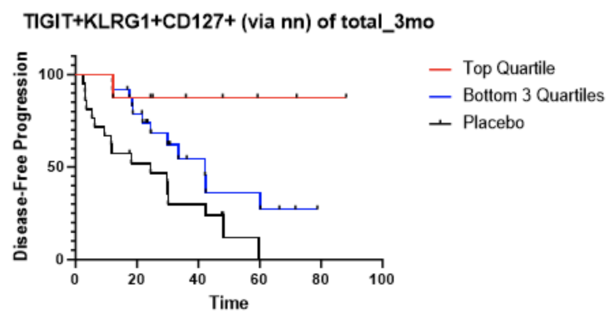
TIGIT⁺KLRG1⁺ non-naïve CD8 subset frequencies also positively associate with outcome in T1D
Diggins et al. (2021) JCI Insight
Joshua Centore
Notes:
This is TN10 (right) and T1DAL (left)
T1DAL trial of alefacept (LFA3-Ig fusion, binds CD2, disrupts CD58-mediated costimulation of T cells, selectively depletes memory/effector T cells) in recent-onset T1D patients
AbATE is recent onset, and TN10 is 14 day course of teplizumab to see if it would delay/prevent stage 3 T1D (clinical diagnosis) in those with high-risk (stage 2 T1D)

Slide 7
Frequency of TIGIT⁻KLRG1⁺CD127⁺ non-naïve CD8s negatively associates with outcome in T1D
*P=0.0919
*P=0.0066
*P=0.0960
Joshua Centore
Notes:
Also share background from Kevan Harold collaboration that CD127 levels in CD8 TEMRAs predict response to teplizumab (low CD127 levels correlate with better response), so even though DP CD127+ good and non-exh CD127+ bad it appears that overall CD127 is bad…
And some evidence for IL7R blockade efficacy delaying diabetes in NOD mice
and AbATE pbmc data showing increased IRs and less CD127 on CD8s in response to teplizumab
TIGIT protective it seems…
This TN10
AbATE is recent onset (2 14 day courses of teplizumab 1 year apart), and TN10 is 14 day course of teplizumab to see if it would delay/prevent stage 3 T1D (clinical diagnosis) in those with high-risk (stage 2 T1D)
Higher levels of (partial) T_{ex} (TIGIT⁺ KLRG1⁺) CD8s associated with
slower progression to T1D
beneficial response to therapy (teplizumab/alefacept) and in at risk for and new onset T1D
Phenotype of islet-reactive CD8s is more so T_{eff}, less so T_{ex}

Slide 8
Central questions
How do different non-naïve CD8 cell populations’ epigenetic profiles differ, and how does this relate to motivating data from previous work?
non-exhausted CD127⁺ vs. exhausted CD127⁺ non-naïve CD8s
exhausted CD127⁺ vs. other exhausted non-naïve CD8s
What insights can we gain into non-naïve CD8 differentiation paths
How do the above results relate to (breakdown of) tolerance in T1D patients?
Notes:
So IL7R seems to associate with worse response, so why are different CD127+ populations differential with association w/ response? Is it just that TIGIT is protective or do these populations have distinct epigenomes?
are PD-1⁺ and CD57⁺ T_{ex} epigenetically exhausted yet distinct here in teplizumab-treated subjects as observed with alefacept in TIDAL (Witkop, Commun Biol)?
T1DAL trial of alefacept (LFA3-Ig fusion, binds CD2, disrupts CD58-mediated costimulation of T cells, selectively depletes memory/effector T cells) in recent-onset T1D patients

Slide 9
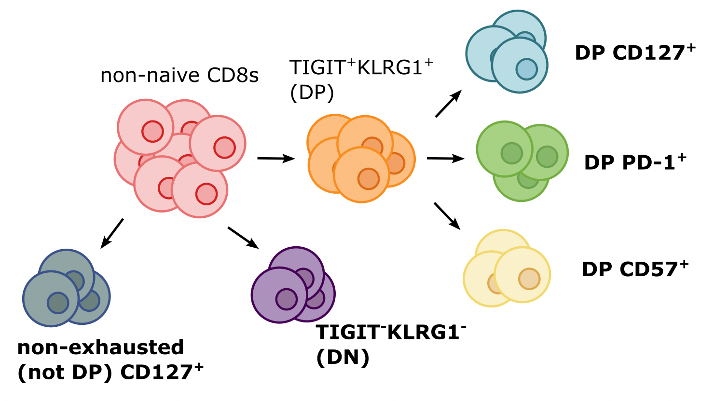
Bulk ATACseq of non-naive CD8 populations from PBMCs in teplizumab-treated T1D patients
DP frequencies associate with positive outcome
Non-exhausted CD127⁺ frequency associates with negative outcome
n = 10,
6 responders,
4 non-responders
Notes:
Sorts inspired by previous work (i.e. TIGIT+KLRG1+ PD-1+/CD57+ and CD127+ and non-exhausted all previously having associations)
10 recent onset treated with teplizumab (6R, 4NR)
teplizumab: 1st FDA approved drug to delay T1D (up to ~2 yr delay), humanized anti-CD3 monoclonal Ab to delay onset of stage 3 T1D in people with stage 2 T1D. mechanism: weak agonist of TCR-CD3 to induce anergy/apoptosis of T cells (i.e. autoreactive Teffs I presume), temporarily induces shift of T cells from periphery to elsewhere (lymph node or bone marrow perhaps) and then when T cells return to periphery in ~1 month it's less effector memory/TEMRA that return so it looks like increased Tex % of total CD8s
PBMCs from recent onset T1D patients, 6 responders (R) and 4 non-responders (NR) to teplizumab, 6 months post-treatment were sorted for bulk ATACseq of the bolded sorts. Rs were chosen for high TIGIT+KLRG1+ fraction of CD8 TEMs, and NRs were chosen for low TIGIT+KLRG1+ fraction of CD8 TEMs.
~equal sex distribution among donors
Ages 10-29, all but 1 in teens

Slide 10
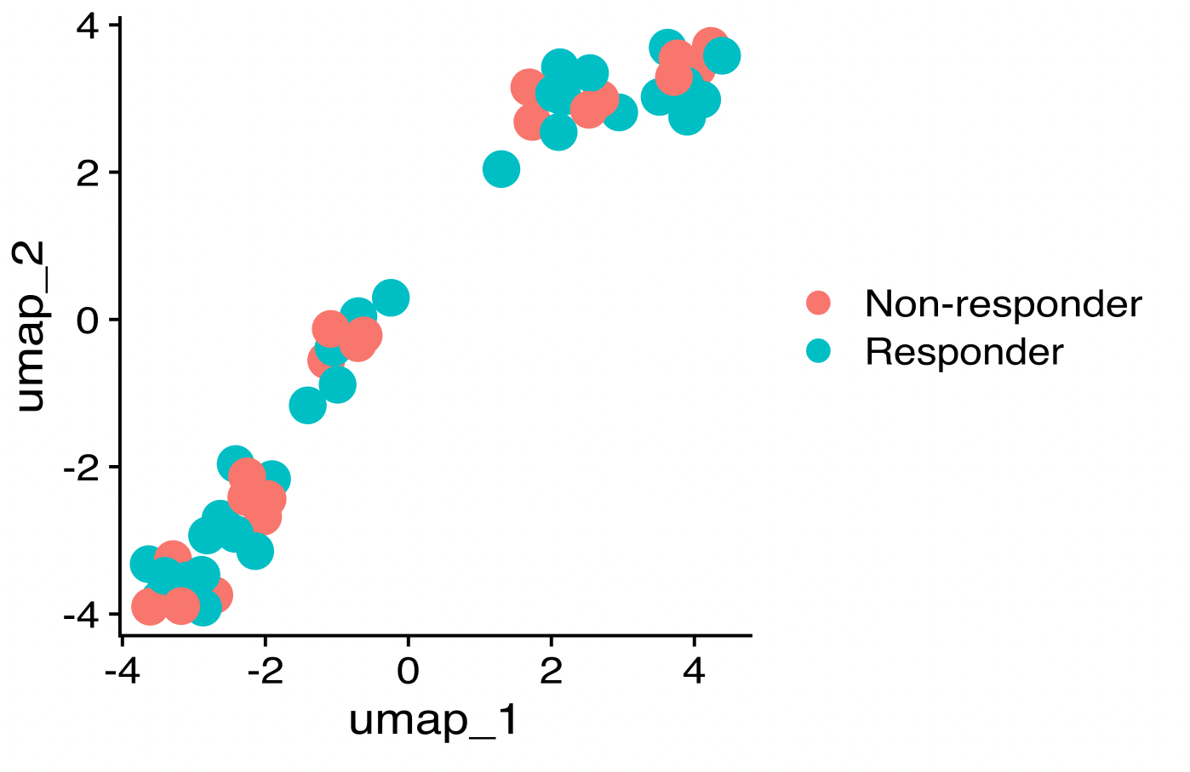
Epigenetic profiles of non-naïve CD8s from R and NR to teplizumab are not clearly distinct
Why don’t we see differences?
Underpowered (n = 10, 6R and 4 NR)
Frequencies of cell types may be different in R vs. NR rather than the phenotypes being distinct
Notes:
teplizumab: 1st FDA approved drug to delay T1D (up to ~2 yr delay), humanized anti-CD3 monoclonal Ab to delay onset of stage 3 T1D in people with stage 2 T1D. mechanism: weak agonist of TCR-CD3 to induce anergy/apoptosis of T cells (i.e. autoreactive Teffs I presume), temporarily induces shift of T cells from periphery to elsewhere (lymph node or bone marrow perhaps) and then when T cells return to periphery in ~1 month it's less effector memory/TEMRA that return so it looks like increased Tex % of total CD8s

Slide 11
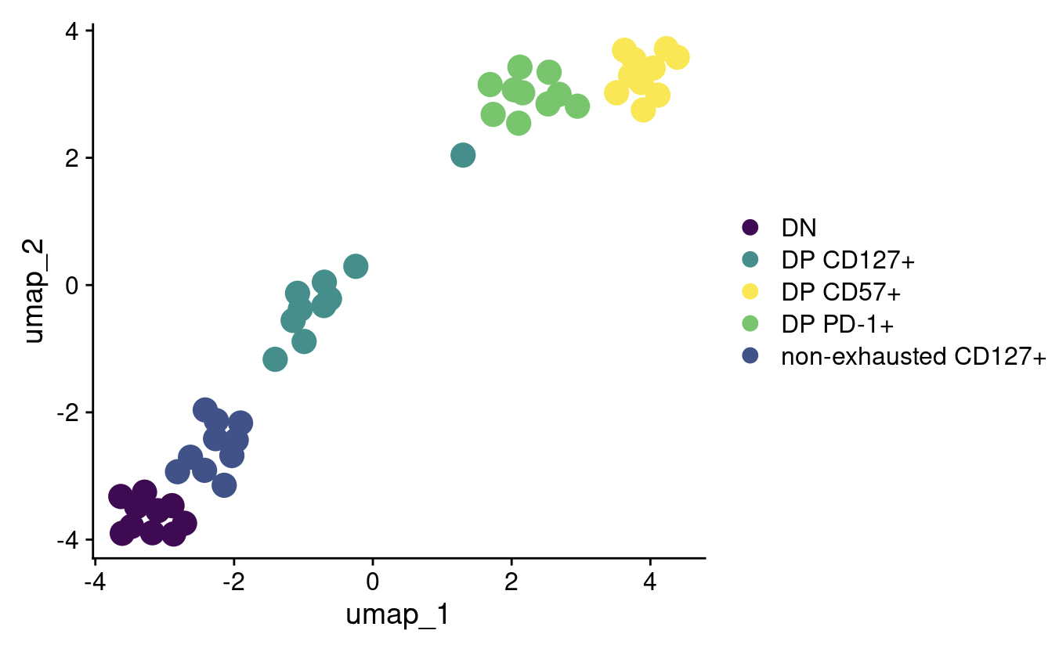
Epigenetic profiles of different non-naive CD8 populations are distinct

Slide 12
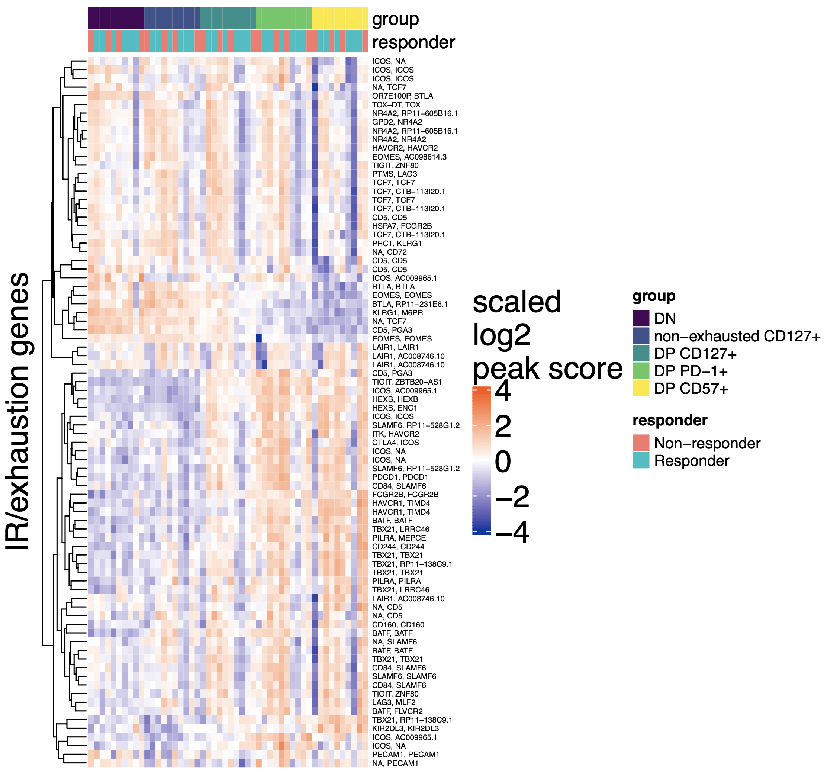
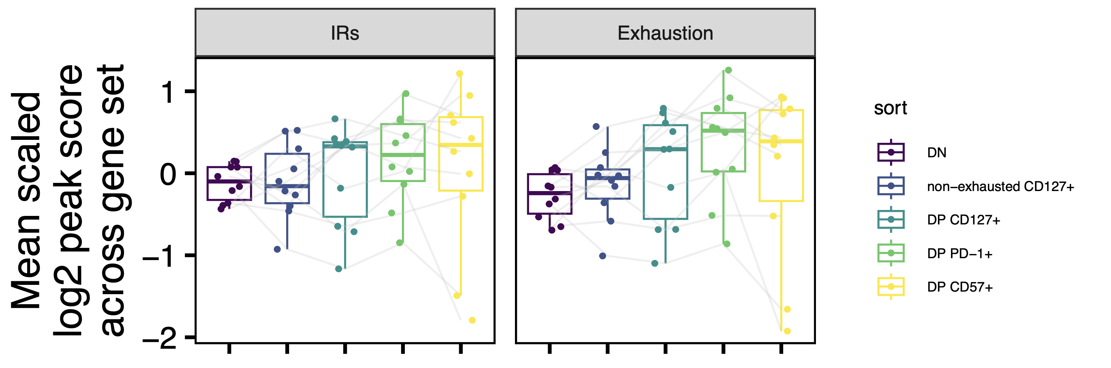
Sanity check: DP non-naïve CD8s do show signs of exhaustion
Notes:
PD1 vs. DN/NAND is marginally significant here for exhaustion I believe
ir_genes [1] "PDCD1" "HAVCR2" "PD1" "CTLA4" "LAG3" "TIM3" "TIGIT" "2B4" "CD160" "BTLA" "CD233" "CD244" [13] "FCGR2B" "PILRA" "FDF03" "CD72" "CD5" "PECAM1" "CD31" "CD22" "CEACAM1" "CD66A" "CD33" "Siglec3" [25] "LAIR1" "KLRC1" "NKG2A" "KIR2DL1" "HAVCR1" "KIR2DL5”
exhaustion_genes <- c("CD244", "SLAMF6", "TBX21", "PDCD1", "HAVCR2", "KLRG1", "TOX", "TCF1", "TCF7", "PD1", "CTLA4", "LAG3", "TIM3", "TIGIT", "KIR3DL2", "KIR2DL3", "NKG2A", "EOMES", "HAVCR1", "CD160", "BATF", "ICOS", "NR4A2”, “HEXB”)
HEXB added because of this paper: https://www.ncbi.nlm.nih.gov/pmc/articles/PMC11315911/

Slide 13
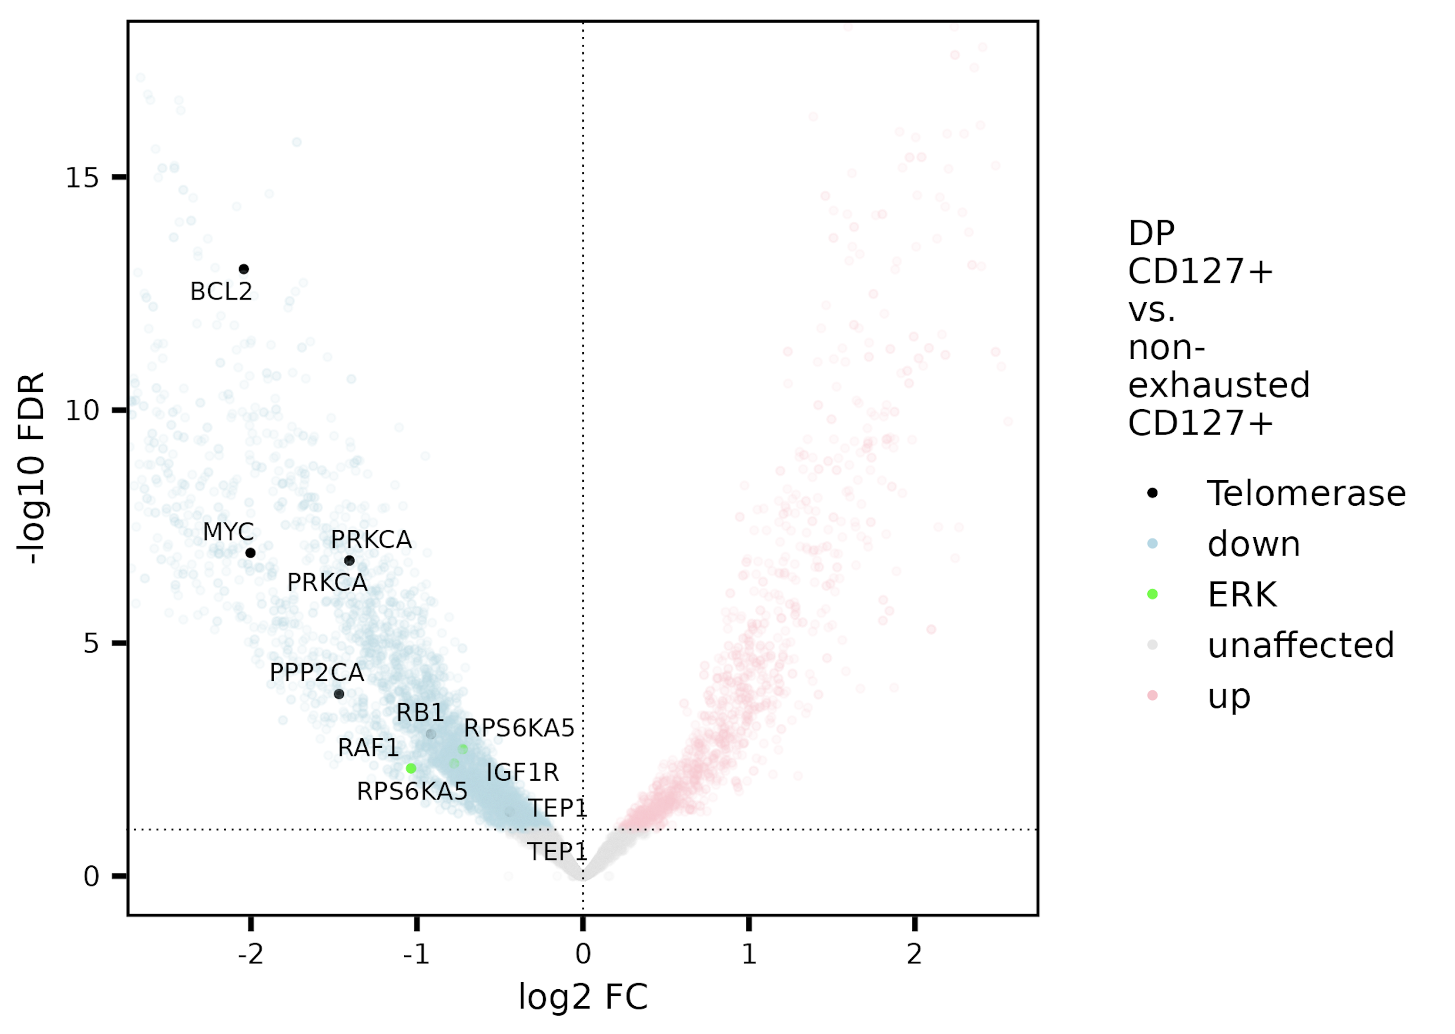
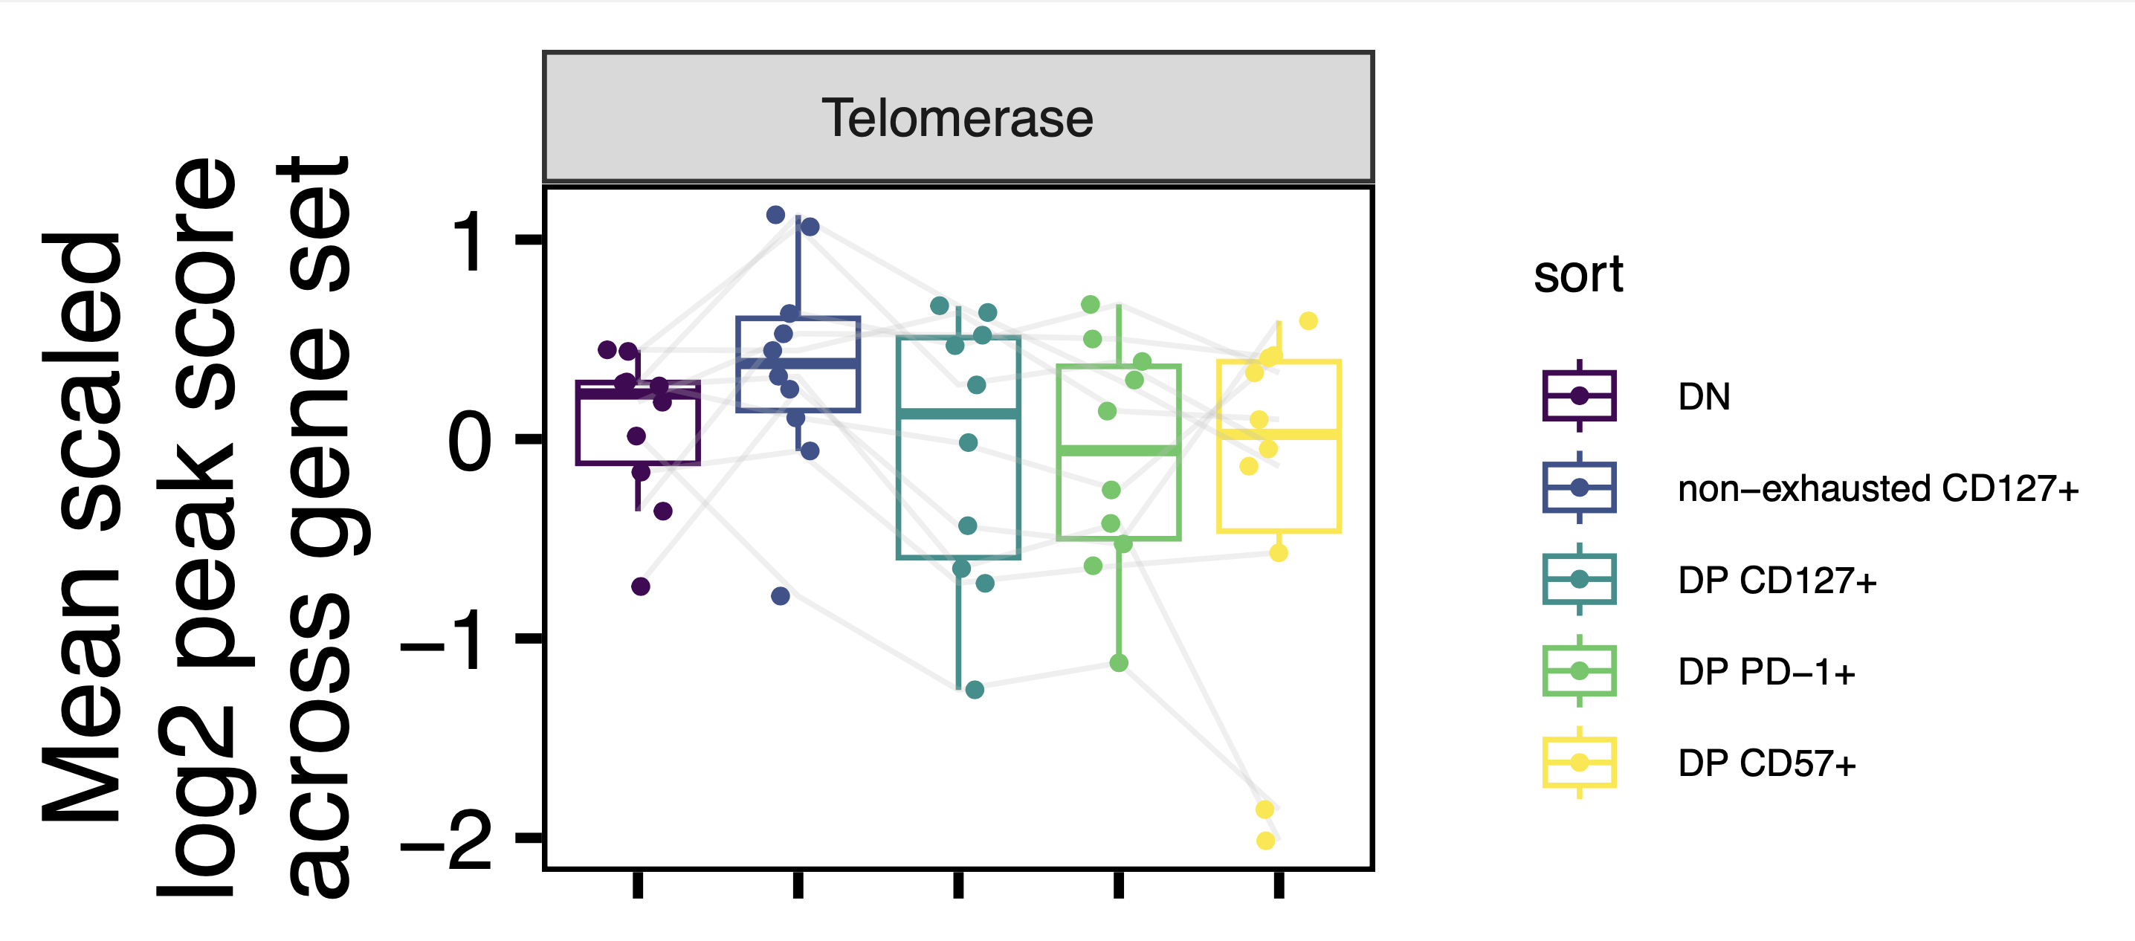
Potential weak effect of telomerase genes more accessible in non-exhausted vs. DP CD127⁺ CD8s
Notes:
Would expect DN high here too, not really…
telomerase_genes [1] "PRKCA" "" "TP53" "RB1" "BCL2" "IGF1R" "AKT1" "HSP90AA1" "TERT" "XRCC6" "MYC" [12] "PPP2CA" "TERF1" "TNKS" "KRAS" "EGFR" "TEP1" "XRCC5”

Slide 14
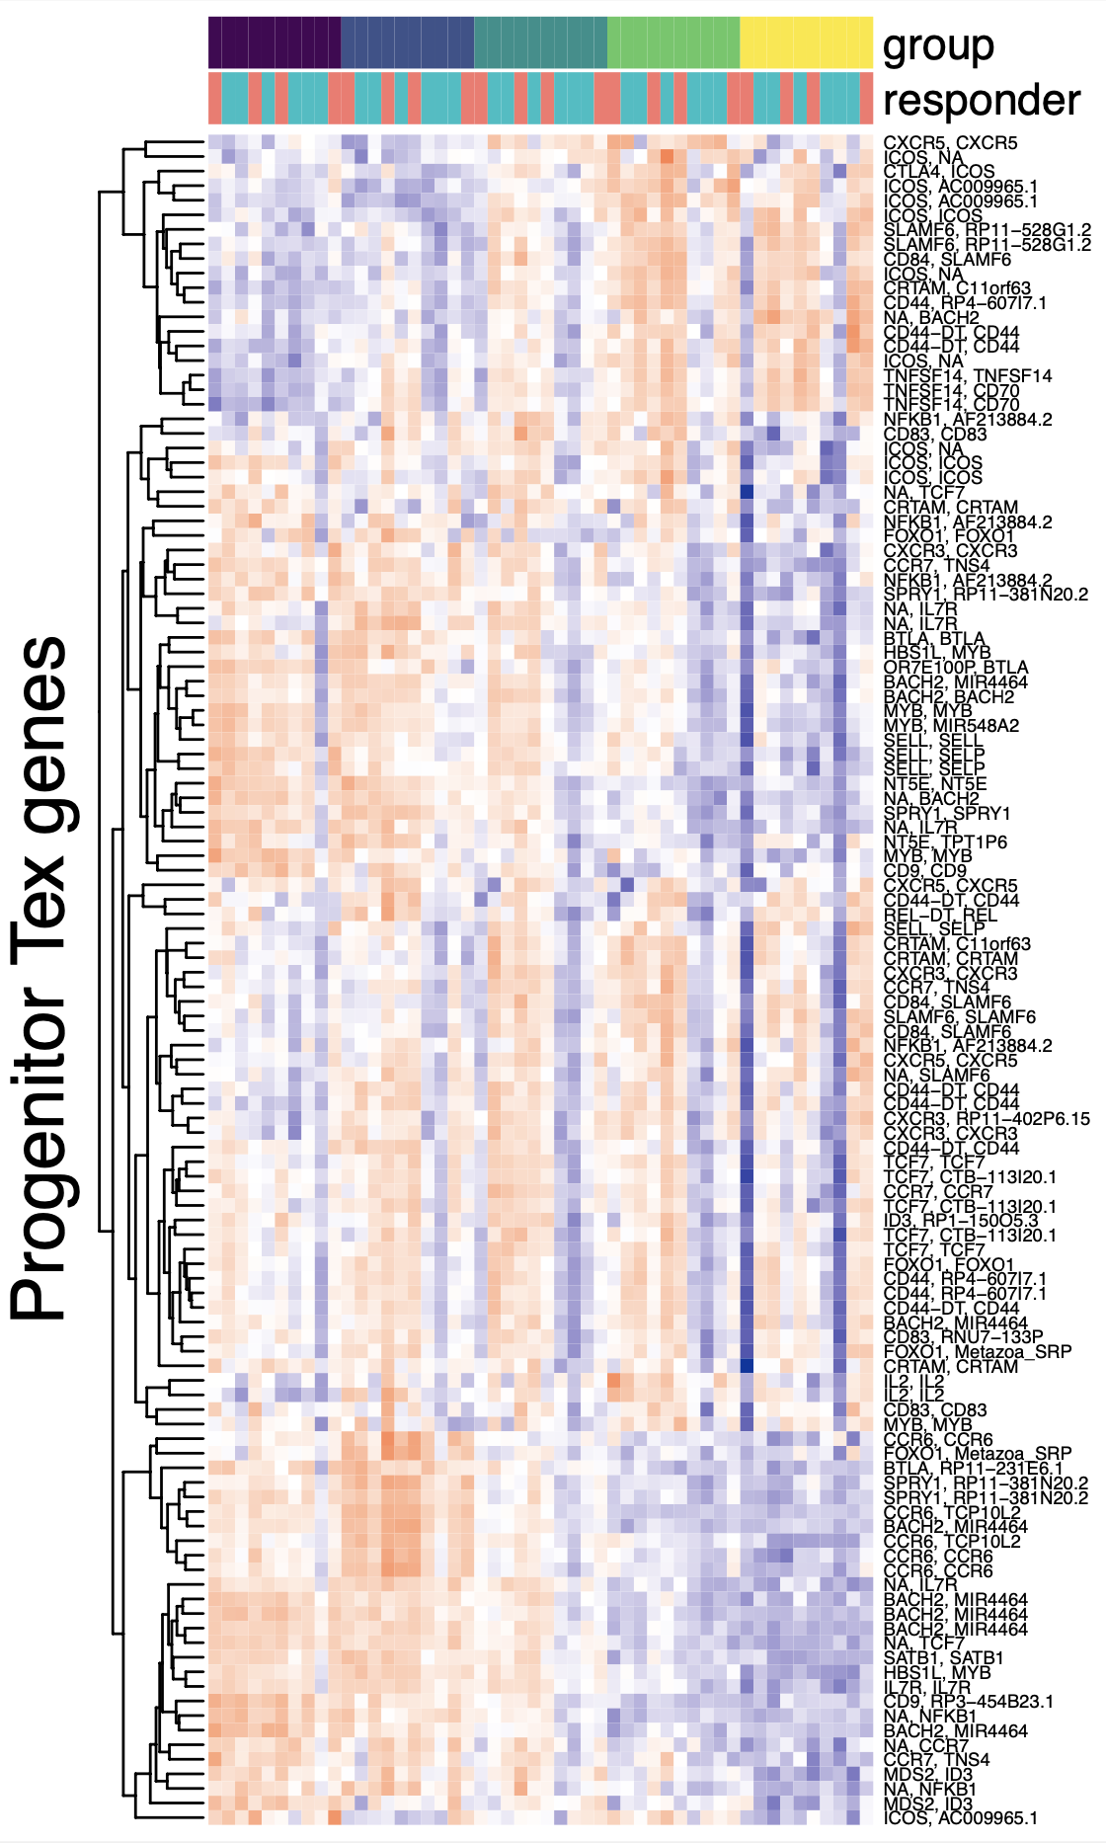
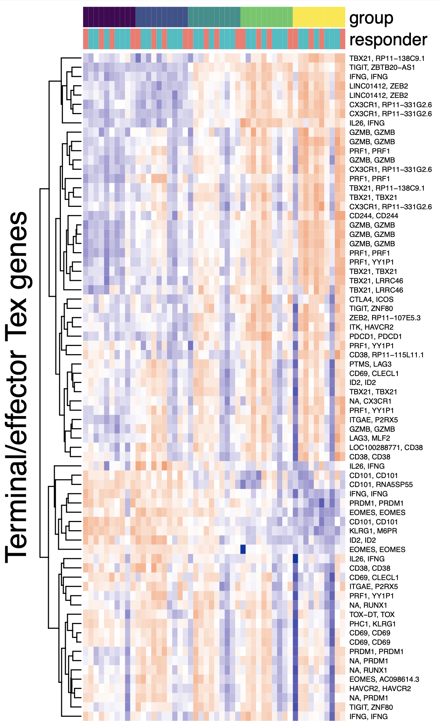
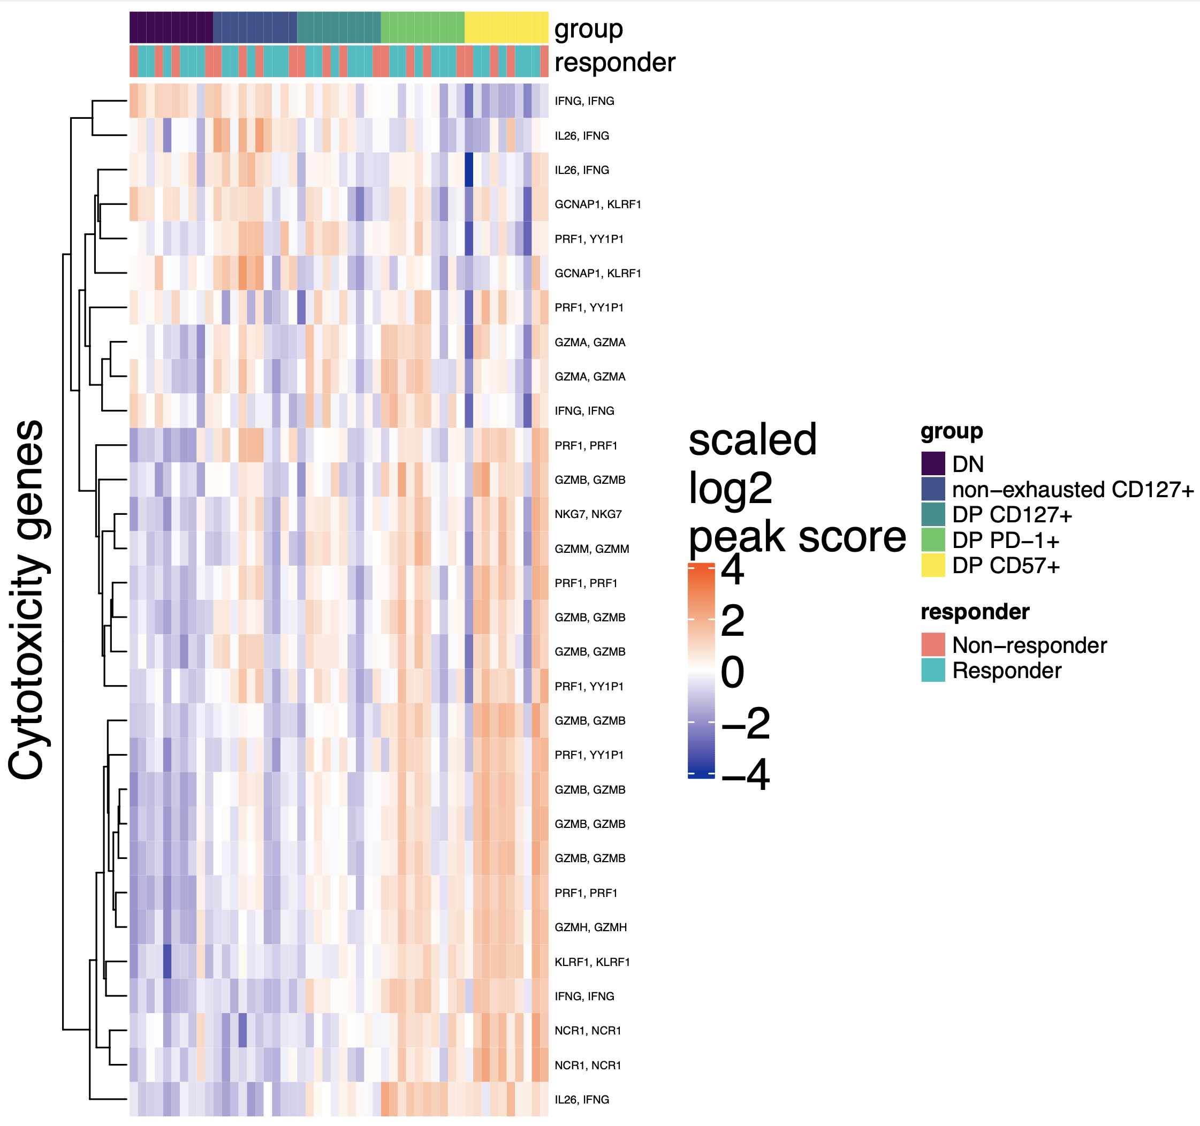
DP CD57⁺ CD8s are less progenitor T_{ex} and more terminal/effector T_{ex,} cytotoxic with DP PD-1⁺ CD8s
Notes:
Progenitor genes (just looking from rownames): NFKB1, CD83, TCF7, CRTAM, FOXO1, ICOS, CXCR5, CCR7, ID3, IL7R, CCR6, BTLA, SELL, NT5E, SLAMF6, CD70, IL2, CRTAM, MYB
Key progenitor genes to mention (consistent mean gene coverage evidence): TNF, IL7R, SPRY1, CXCR5, CD73 (NT5E), CCR7, SELL, CD9
terminal_genes [1] "CD38" "ID2" "PRF1" "IFNG" "PRDM1" "CX3CR1" "CD101" "TOX" "CD39" "HAVCR2" "CD244" "GZMB" "RUNX1" [14] "TIGIT" "PDCD1" "LAG3" "CD244" "ITGAE" "CTLA4" "EOMES" "TBX21" "ZEB2" "KLRG1" "CD69”
Key terminal genes to mention (consistent mean gene coverage evidence): CX3CR1, ZEB2, CD38, PRF1, PRDM1, GZMB
cytotoxicity_genes [1] "GZMA" "GZMB" "GZMH" "GZMM" "GZMK" "PRF1" "NCR1" "KLRF1" "NKG7" "IFNG

Slide 15
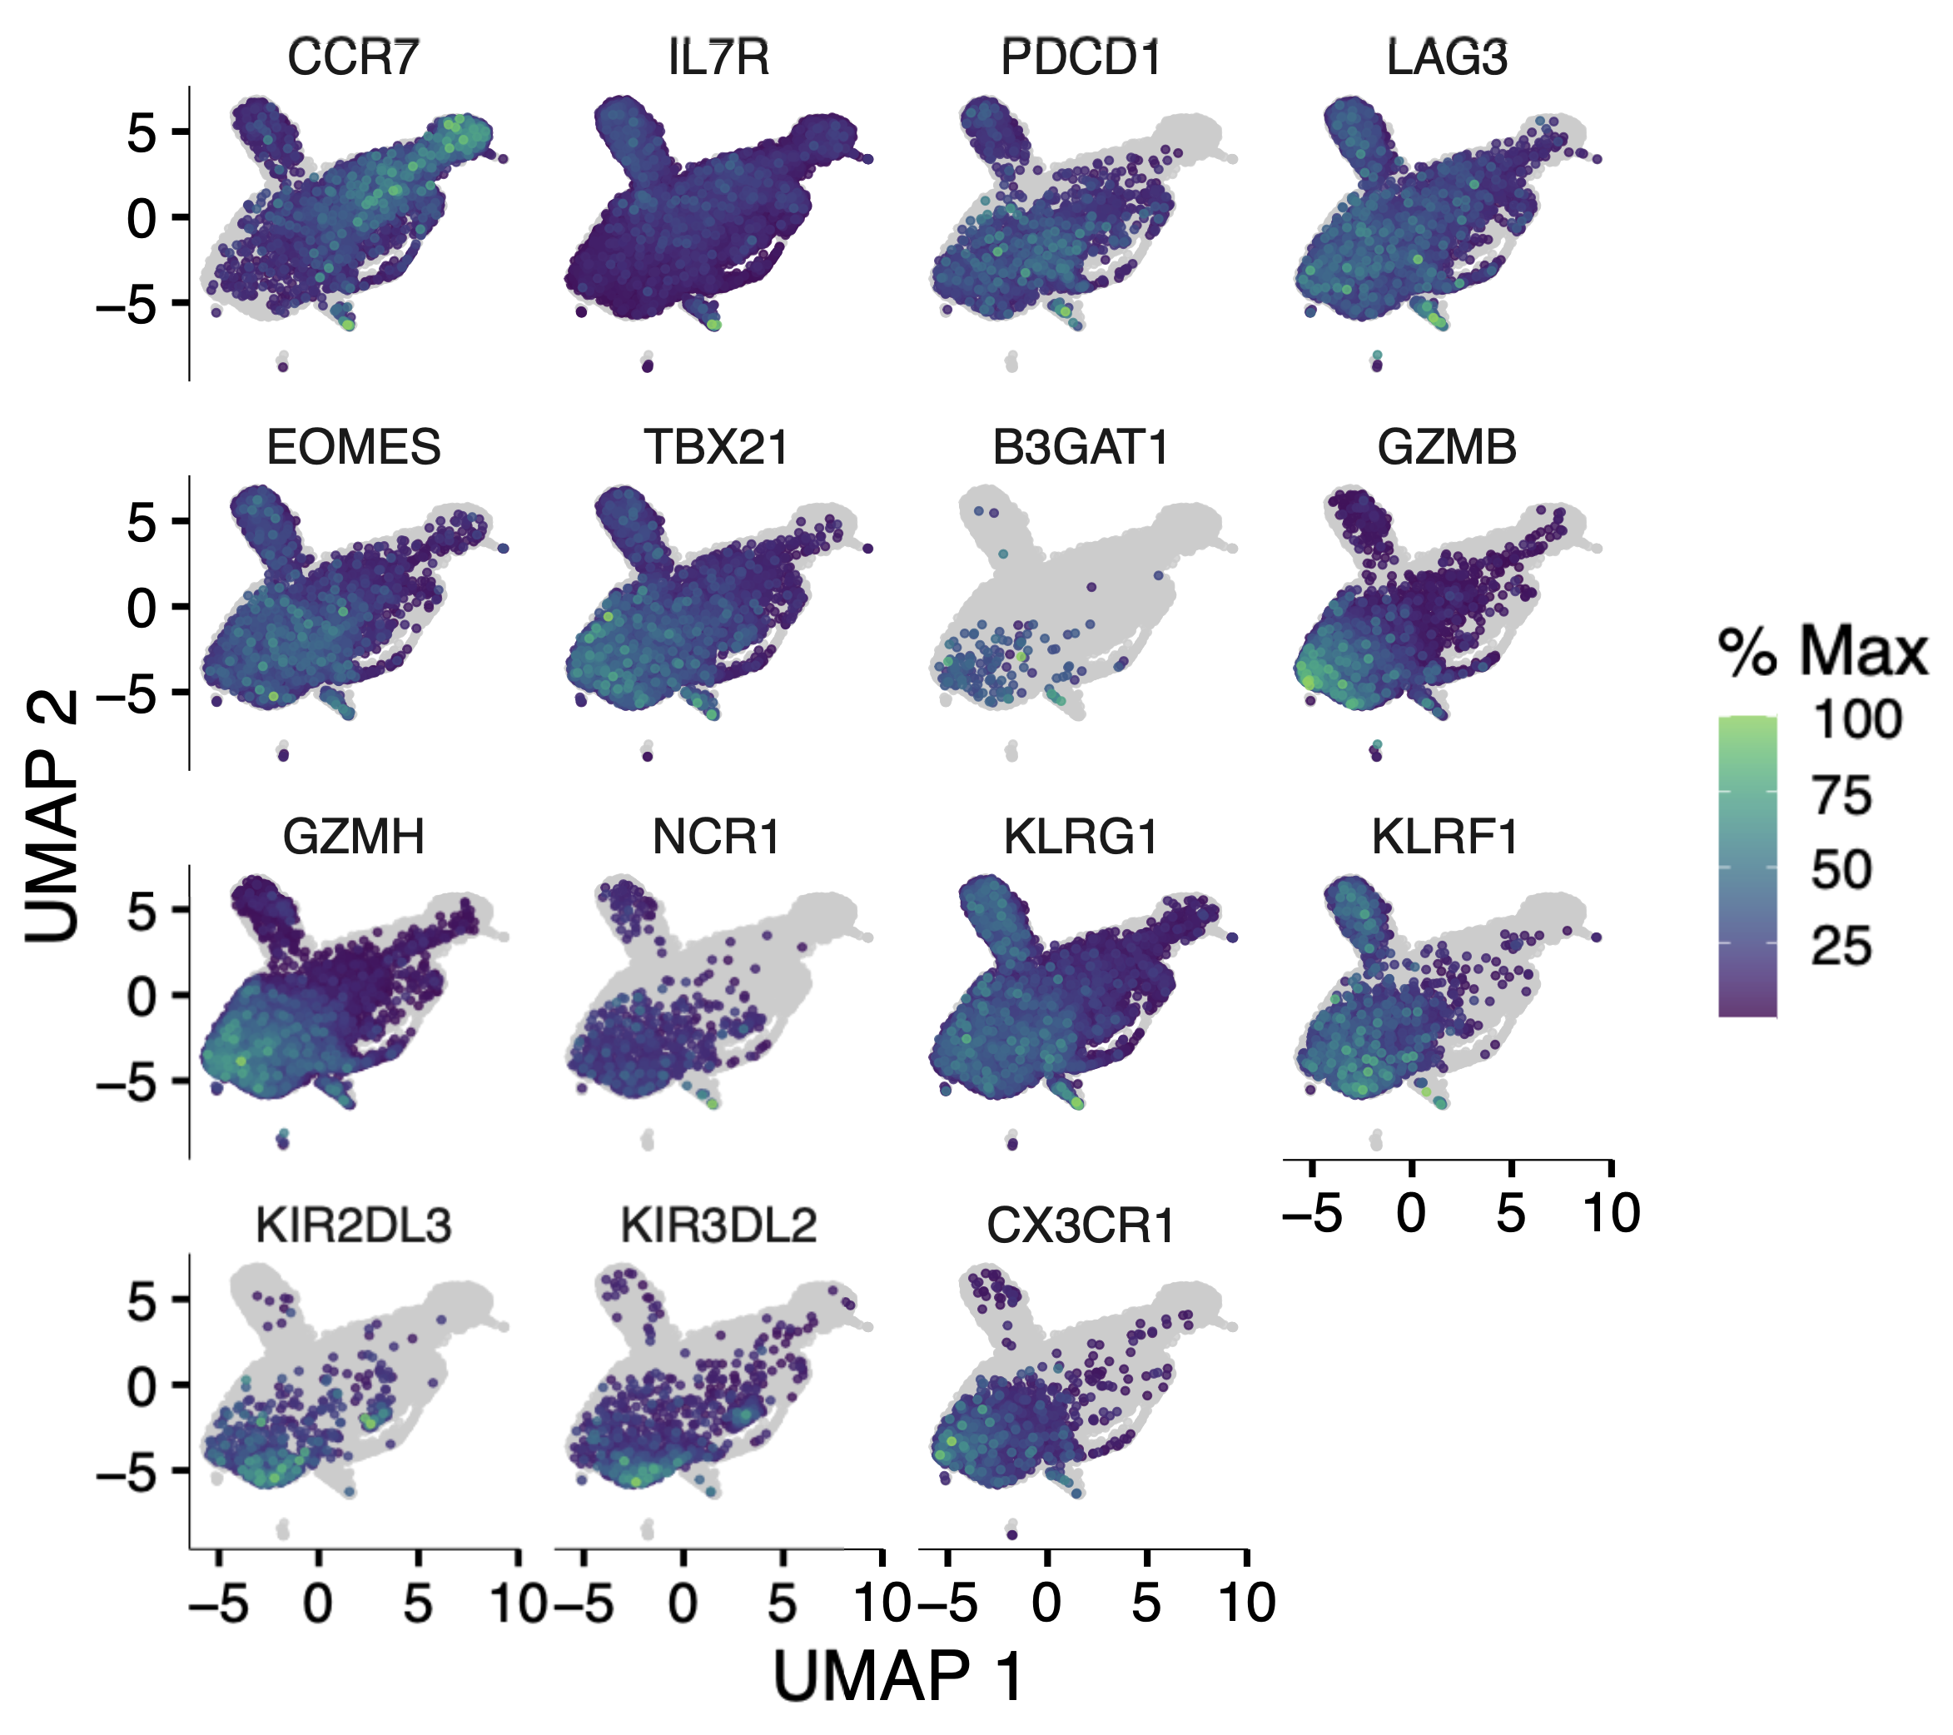
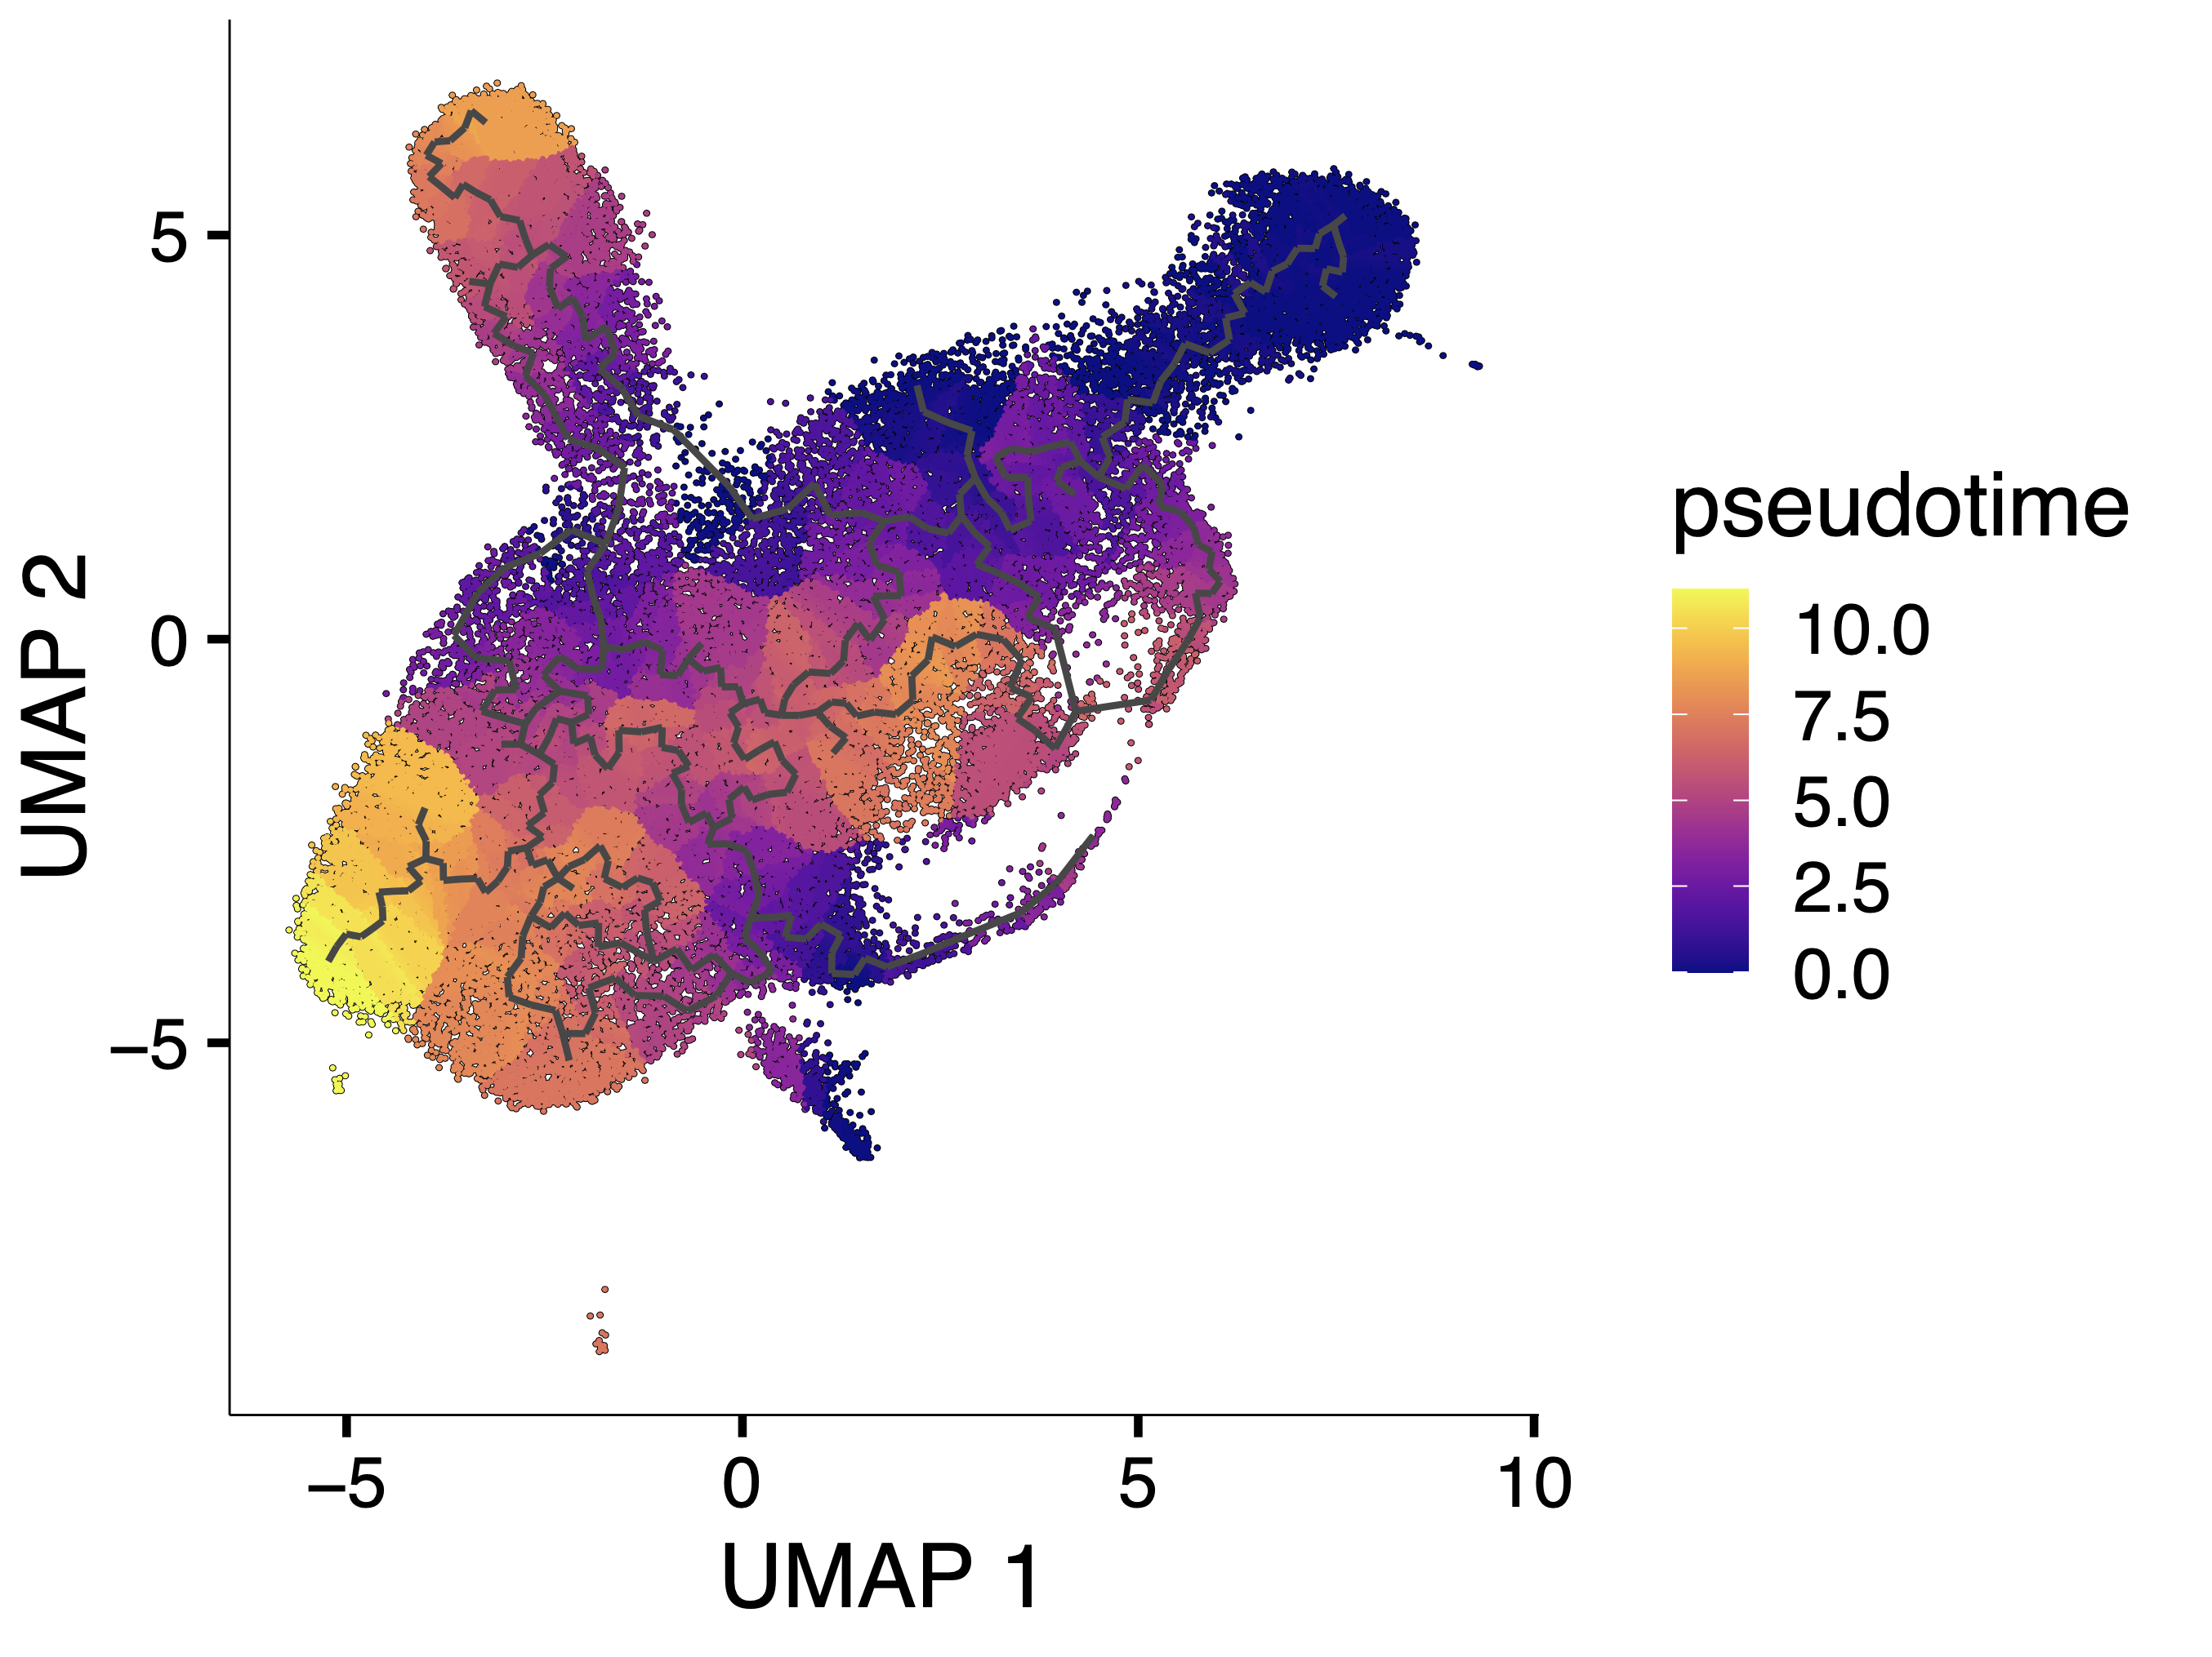
CD57⁺ CD8s have high pseudotime values in scRNAseq experiment of T1D patients
Basilin Benson
Notes:
CD57s appear terminal here based on high pseudotime in CD57 population
Pseudotime inference aims to infer the ordering of cells along a lineage based on the cells’ gene expression profiles measured by scRNA-seq, “pseudotime,” is the time-like variable indicating the relative position a cell takes in a lineage
at a high level: once the user specifies the root, monocle just looks for what's most distinct transcriptionally (so the other end), and then orders cells based on progression in a "line" from root to end (ignoring branches for now)
branches then come from divergences in transcriptional states, pseudotime calculated relative to parent in tree

Slide 16
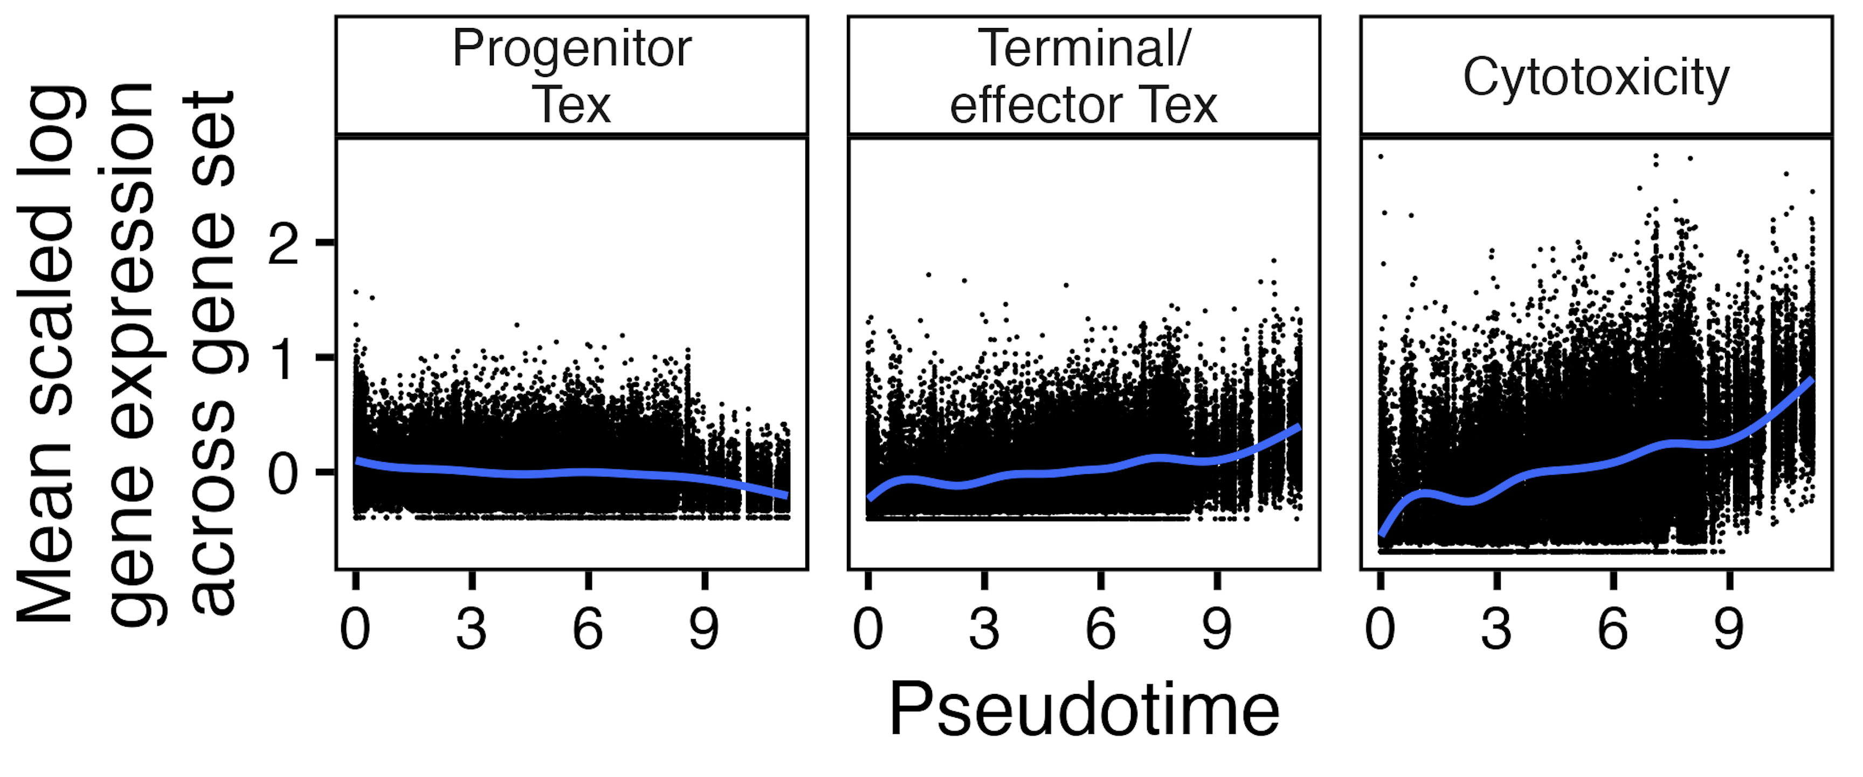
Transcriptomic phenotype of cells later in pseudotime is more cytotoxic and terminal/effector T_{ex}
Notes:
RNA expression
Z-score transformation (mean = 0, SD = 1) is applied to each gene's expression across all cells to get this scaled.data that I used for yvals here
Better ylab is Mean z score of genes in …?
Smoothing curve: geom_smooth(method = "gam", formula = y ~ s(x, bs = "cs", k = 10), se = TRUE) +
"cs": Cubic regression splines with shrinkage, which can reduce overfitting

Slide 17
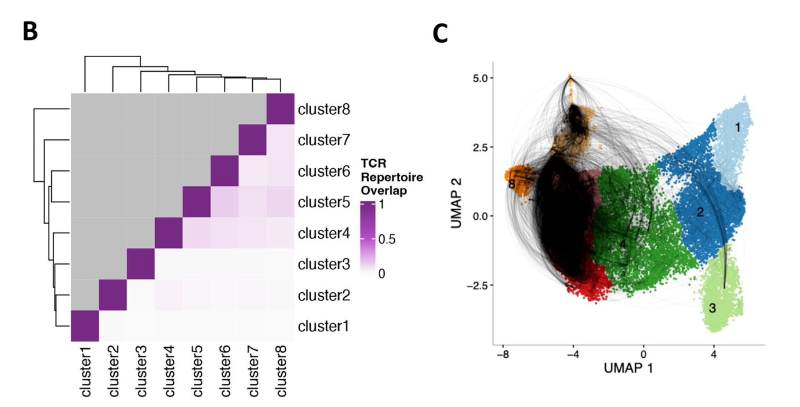
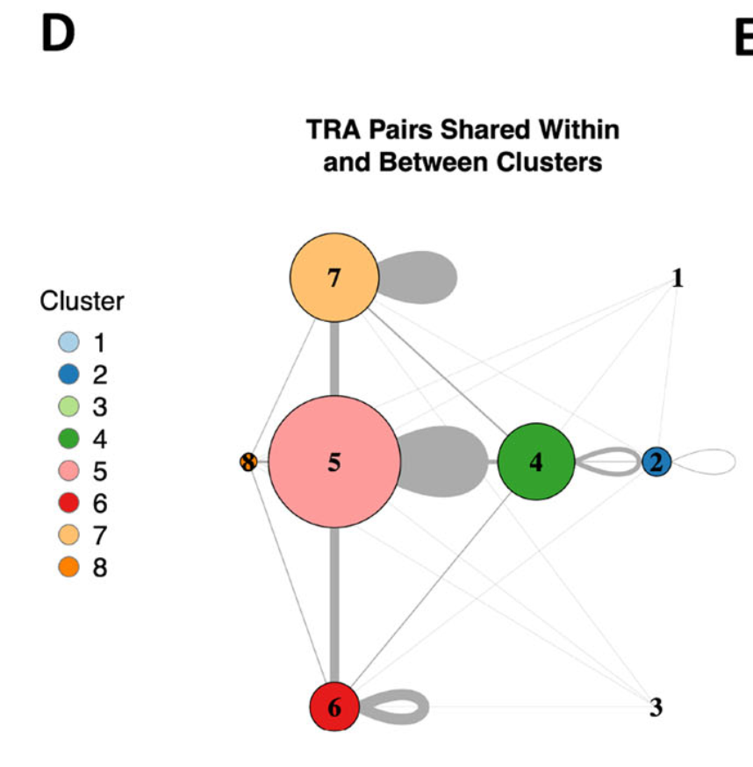
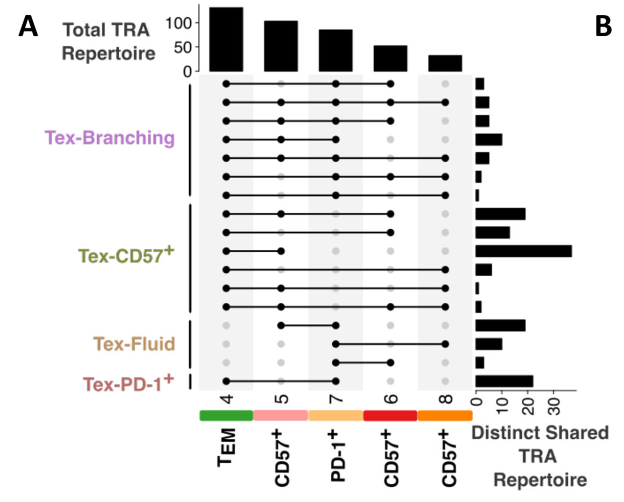
PD-1⁺ and CD57⁺ T_{ex} populations share a common lineage, population fluidity
Witkop et al. (2024). Commun Biol
Notes:
T1DAL
But who came first? Perhaps our work here can shed light on PD-1+ perhaps being parent to CD57 (MT SNVs, and more progenitor Tex?)

Slide 18
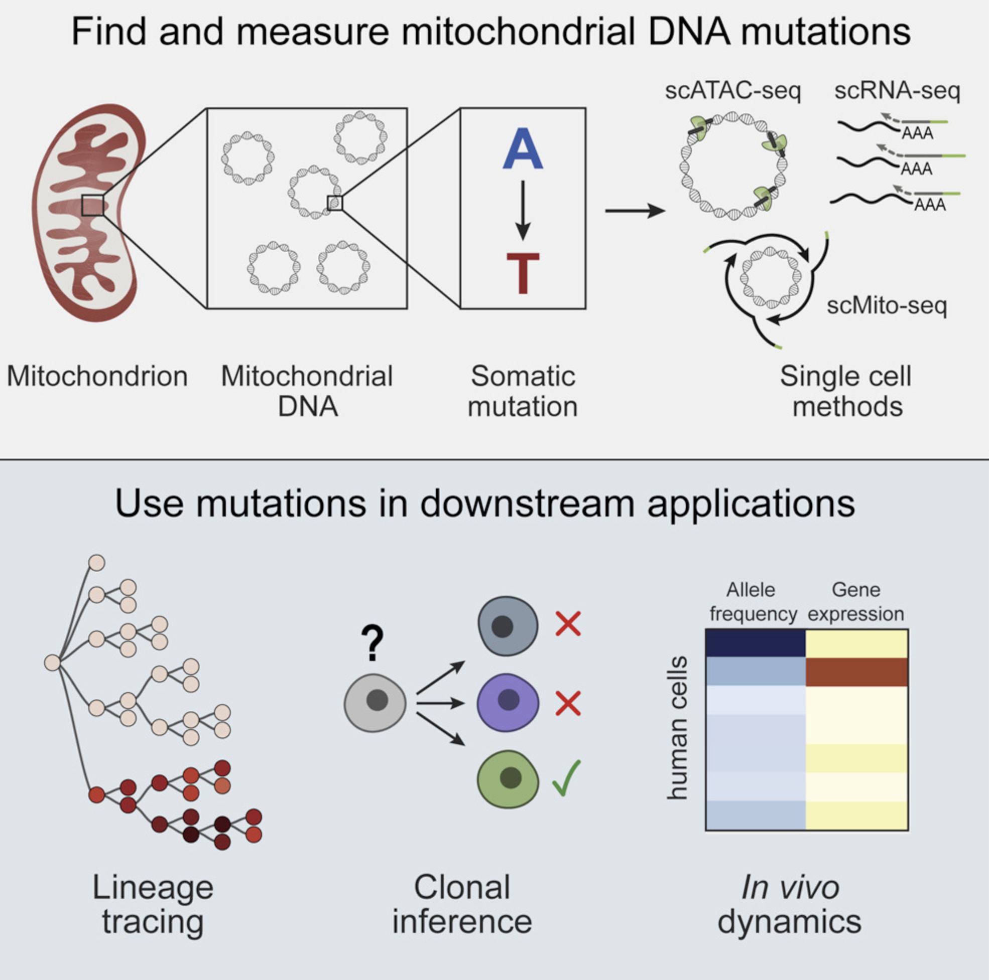
Mitochondrial DNA mutations have been used to trace lineages in hematopoietic cells
MT DNA…
has much higher mutation rate than nuclear DNA
is very accessible to transposase (no histones)
Ludwig et al. (2020) Cell
Notes:
MT notes:
Mitochondrial genomes have high copy number (100–1,000s)
homoplasmy is when all copies of the mitochondrial genome in a cell are identical; heteroplasmy is when there is a mixture of two or more mitochondrial genotypes
mutations in mtDNA often reach high levels of heteroplasmy (proportion of mitochondrial genomes containing a specific mutation) due to a combination of vegetative segregation, random genetic drift, and relaxed replication
Exclusively maternal inheritance
mtDNA mutation rates are estimated to be 10- to 100-fold higher than for nuclear DNA
Although there are no histones in mitochondria, mtDNA does not exist in a ‘naked' form. It is packaged into nucleoids, which are DNA–protein assemblies composed of mtDNA surrounded by core and peripheral nucleoid factors

Slide 19
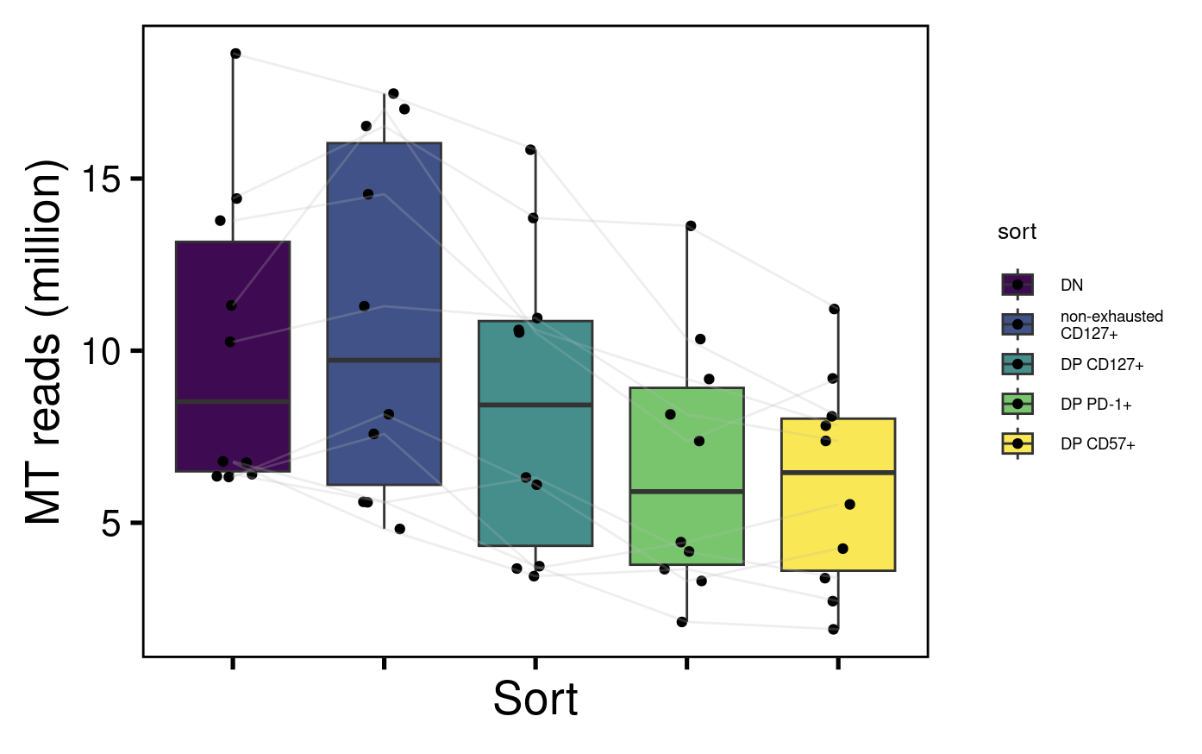
~5-15% of reads map to mitochondrial genome, similar levels across cell sorts

Slide 20
Using VarScan2 to identify mitochondrial single-nucleotide variants
Extract MT mapping reads from alignment bam files
Create pileup files using samtools
Run Varscan2: calls variants that meet desired thresholds for read depth, base quality, variant allele frequency, statistical significance
Filter out possible sequencing/mapping errors
> 2 supporting reads/variant on both strands
no strand bias (no fewer than 30% and no more than 70% of reads for a specific variant on either strand)
Filter out variants present in all cell sorts within a donor (uninformative)
Koboldt et al. (2012) Genome Research
Notes:
Varscan
Parses pileup input 1 base at a time, computing number of bases supporting each observed allele
Only bases meeting minimum base quality (default: 20) from reads meeting minimum mapping quality (default: 1) are considered
Coverage (number of qualifying bases) is calculated
If coverage meets minimum threshold, then VarScan examines each observed allele to test if it was…
supported by minimum number of supporting reads
meets minimum allele frequency threshold (min_var_freq, 0.3% here)
passes basic strand-bias filter
has Fisher’s exact test pval < 0.05
Only bases meeting minimum base quality (default: 20) from reads meeting minimum mapping quality (default: 1) are considered
VarScan employs a robust heuristic/statistic approach to call variants that meet desired thresholds for read depth, base quality, variant allele frequency, and statistical significance.
Min_coverage param does seem to matter somewhat… with higher value (20 vs. 8), trends seem more extreme, I think this is fine even if 8 is default value as 20 is more stringent…
VarAllele Most frequent non-reference allele observed, this is what I use for sharing analyses
Pileup file: desribes the base-pair information at each chromosomal position. This format facilitates SNP/indel calling and brief alignment viewing by eyes. each line consists of chromosome, 1-based coordinate, reference base, the number of reads covering the site, read bases and base qualities. At the read base column, a dot stands for a match to the reference base on the forward strand, a comma for a match on the reverse strand, `ACGTN' for a mismatch on the forward strand and `acgtn' for a mismatch on the reverse strand. A pattern `\+[0-9]+[ACGTNacgtn]+' indicates there is an insertion between this reference position and the next reference position. The length of the insertion is given by the integer in the pattern, followed by the inserted sequence.

Slide 21
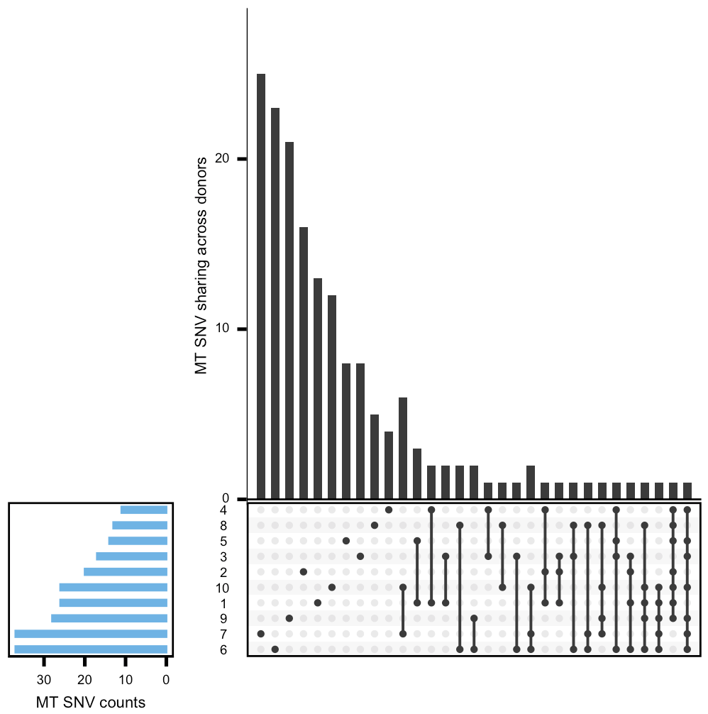
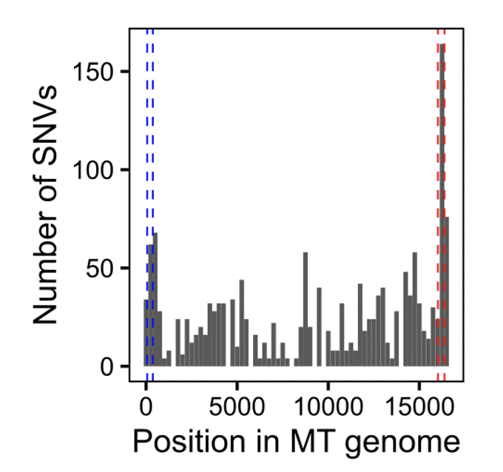
Mitochondrial single-nucleotide variants are mostly private within donors and are enriched within HVs
DonorID
HV2
HV1
Notes:
MT SNVs called using VarScan. (left) Upset plot showing sharing of MT SNVs across donors. (right) Distribution of MT SNVs across MT genome with hypervariable regions highlighted (HV1 in red, HV2 in blue)

Slide 22
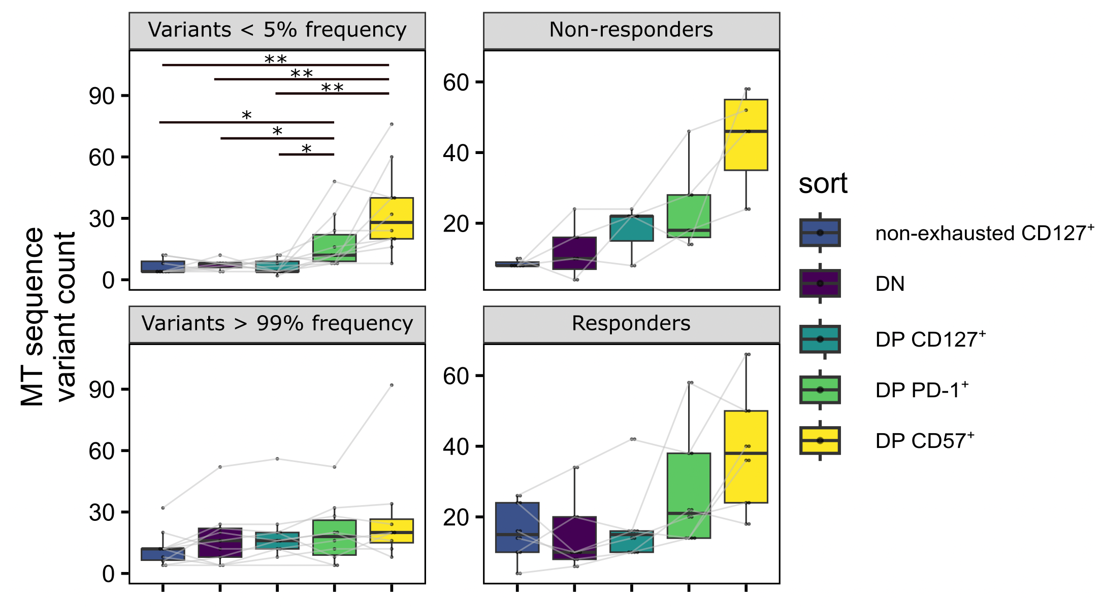
DP CD57⁺ and DP PD-1⁺ non-naïve CD8s have more low-frequency MT SNVs
Wilcoxon rank sum test. **, padj < 1e-2; *; padj < 0.05
Notes:
Accumulated over cell divisions, MT SNVs can provide directionality in a differentiation pathway
Mitochondrial single nucleotide variant (MT SNV) counts faceted by variant frequency or responder status
Yes, we do see more sharing of SNVs across sorts in high freq group than in low freq group
bimodal "issue" also present in T1DAL, and for both projects it seems like medium frequency vars are preferentially present in all sorts in a donor, so removed...

Slide 23
Summary
Epigenetic profiles of non-naïve CD8s from R and NR to teplizumab are not clearly distinct
Epigenetic profiles of different non-naïve CD8 populations are distinct
as expected, TIGIT⁺KLRG1⁺ non-naïve CD8s show signs of exhaustion
potential weak effect of telomerase genes more accessible in non-exhausted vs. DP CD127⁺
DP CD57⁺ non-naïve CD8s have epigenetic profile less of progenitor T_{ex} and more of cytotoxic terminal/effector T_{ex}, DP PD-1+ also more cytotoxic
MT SNVs
MV SNV counts similar between R and NR to teplizumab
DP PD-1⁺ and DP CD57⁺ non-naive CD8s have more low-frequency MT SNVs than other non-naive CD8s
Notes:
NAND vs. DP CD127+: similar epigenetics, differential association w/ outcome may just be due to TIGIT protection
MT SNV data is consistent with epigenetics AND builds upon Erin’s work (PD1 CD57 fluid but didn’t know directionality)

Slide 24
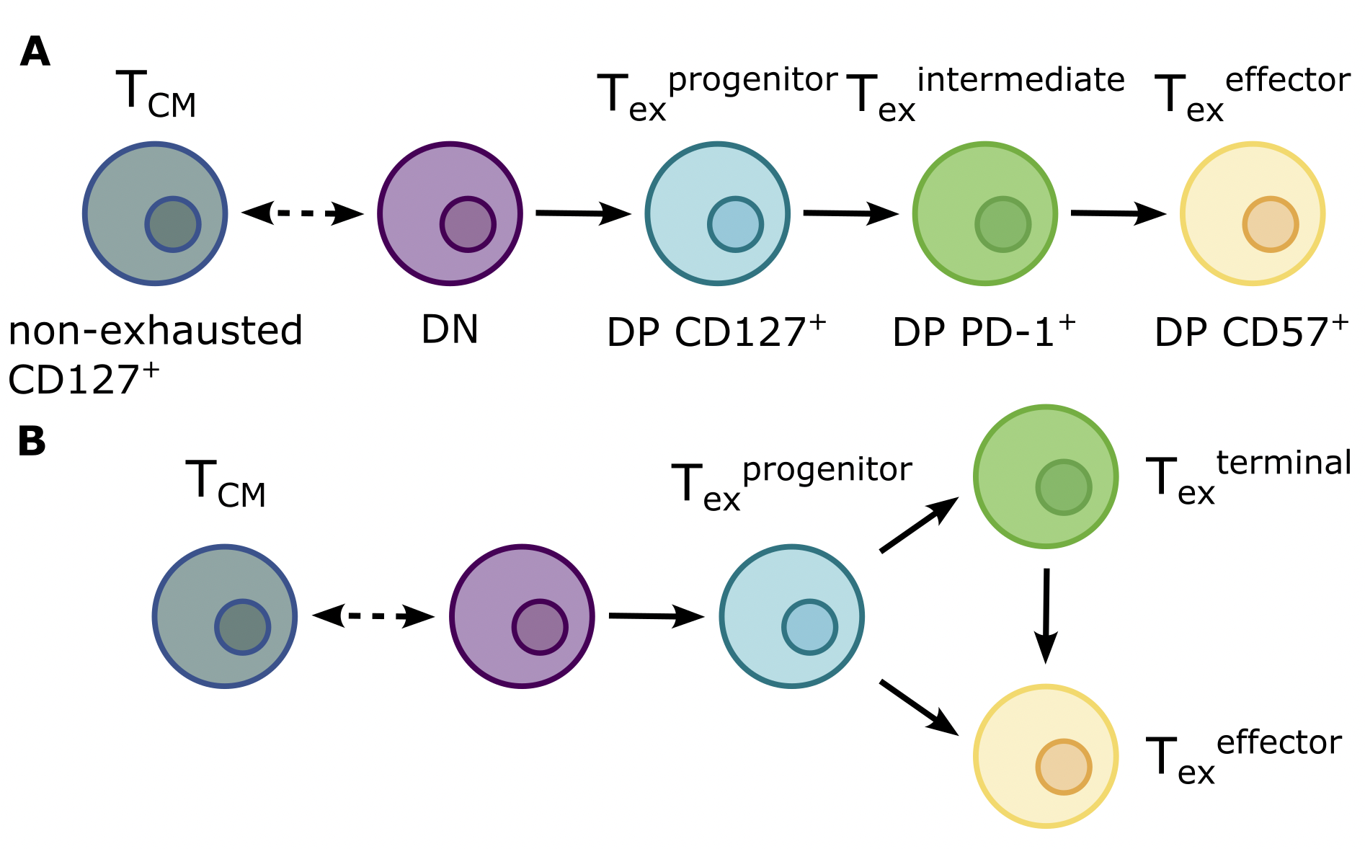
Conclusion
Non-exhausted CD127⁺ frequency associates with negative outcome
DP frequencies associate with positive outcome
Notes:
Verbally share conclusion as DP CD57 as most terminal followed by DP PD-1, DP CD127 and maybe DP PD1 too ~progenitor Tex or maybe like in model A DP PD-1 is intermediate Tex
But why are more terminal cells good? Is it just because they’re restrained/exhausted-like? Perhaps not, as non-exhausted CD127+ cells produce less cytokines (consistent with cytotoxicity program more accessible in later sorts)
Maybe just flux through differentiation is good for outcome? More flux due to more antigen stimulus. antigen is a hypothesis (total flux through differentiation), but in line with rate limit of particular step it could also be specific differentiation step's flux important (or interruption of specific differentiation step)
Complicated by us not knowing if islet-autoreactive frequencies follow same associations as general unsorted DP…
High TCR signaling avidity has been shown to correlate with terminal Tex phenotype, low avidity with KLR effector-like Tex phenotype, so more expansion for terminal Tex than KLR Tex, so this is a little inconsistent with here DP CD57s having more SNVs than DP PD-1s… that is if DP PD-1s are terminal Tex, maybe they’re intermediate Tex (why I’m leaning linear model)
Maybe there’s an unknown sort in model A) after intermediate Tex (i.e. there could be a bifurcation with 1 arm to effector Tex and 1 arm unshown)
Texprogenitor may be same/similar cells to those whose frequency correlates with response in cancer immunotherapy (respond to ICB)
One thing that doesn’t make the most sense here is stronger antigenic stimulus would lead to higher clearance of beta cells then and worse autoimmunity… right?
Chang, Egawa, Satpathy groups for divergent Tex in chronic viral infection in mice
Leaning towards model A?
Texprogenitor may be same/similar cells to those whose frequency correlates with response in cancer immunotherapy (respond to ICB)

Slide 25
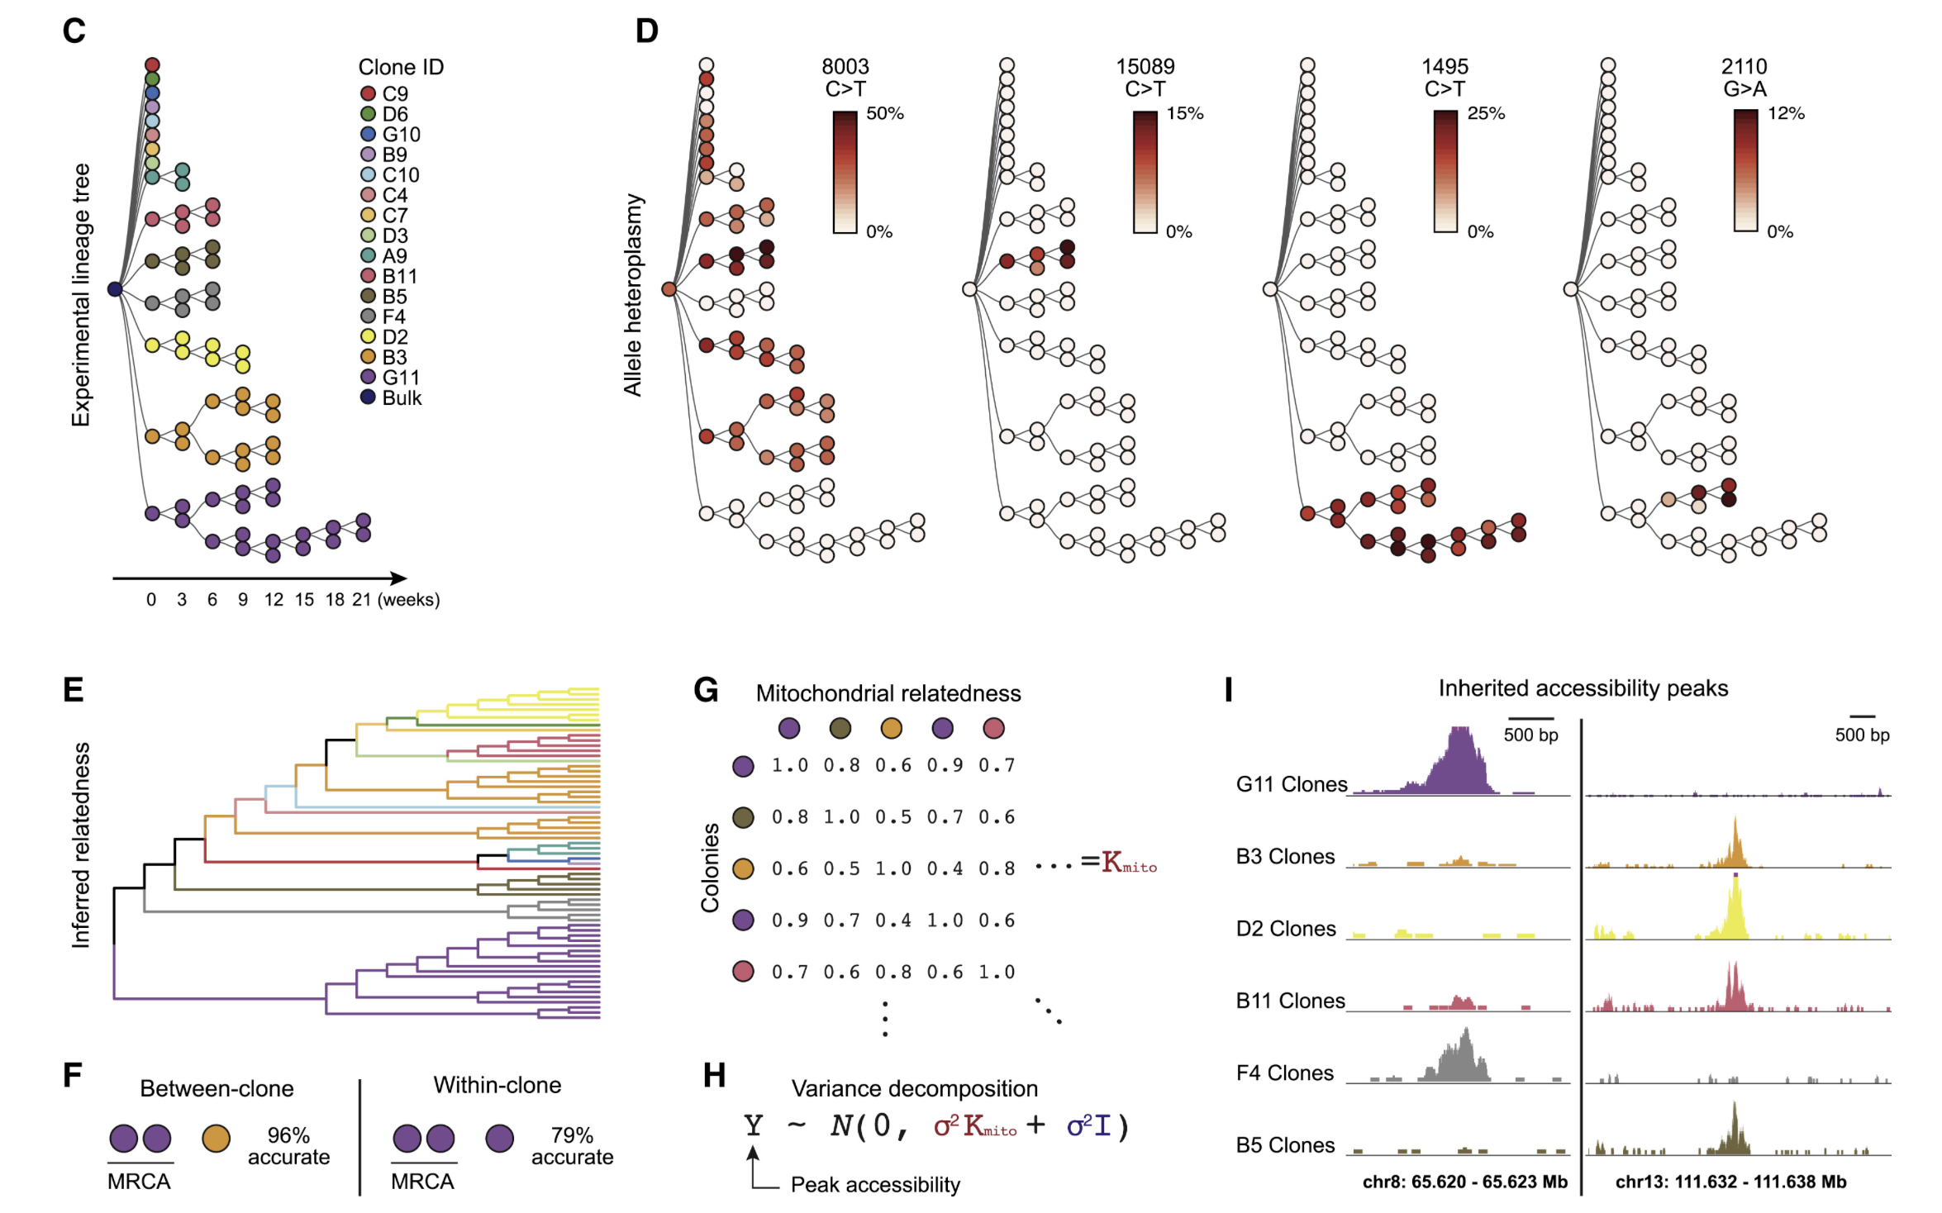
Next steps
Using MT SNVs from scATACseq to map lineages
scATACseq: trace lineages using MT SNVs to differentiate between these (and more complex) models
Confirm that MT SNV counts are proportional to accumulated cell division count (pulse chase mass spectrometry of immune cells in T1D)
Assess non-naïve CD8s’ specificities/TCR avidities
Ludwig et al. (2020) Cell
Notes:
For point 3: specificities (like do we see autoantigen-specific DP frequency associating with good outcome too?) and TCR avidity (higher more terminal sort?)
Other models could include branches rather than bifurcations (i.e. cell type A stays A and branch B comes off it)
For sc lineage tracing, I think sorts should include some stuff from along each “step” of lineage, proof of concept using Allen Institute TEAseq data
Plan: create fig E diagram and color by cell sort
Perhaps would want to change sorting strategy to include parent DP. PD-1⁺ and CD57⁺, or CD127⁺ ever co-expressed?
High TCR signaling avidity has been shown to correlate with terminal Tex phenotype, low avidity with KLR effector-like Tex phenotype, so more expansion for terminal Tex than KLR Tex, so this is a little inconsistent with here DP CD57s having more SNVs than DP PD-1s… that is if DP PD-1s are terminal Tex, maybe they’re intermediate Tex (why I’m leaning linear model)
use tetramer binding level as a proxy for TCR avidity
Other idea: scRNAseq
allows RNA velocity
would get even fewer MT reads (not all MT genome transcribed)

Slide 26
Extra slides

Slide 27
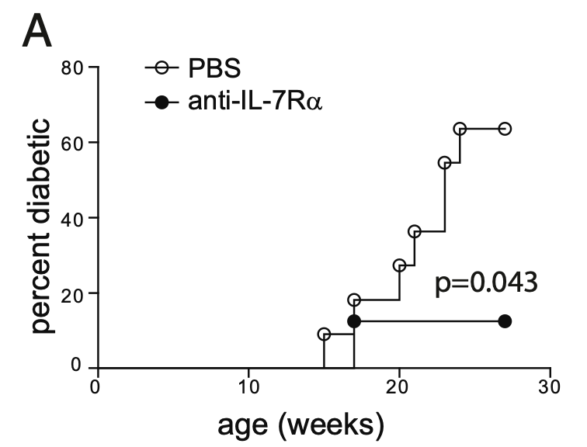
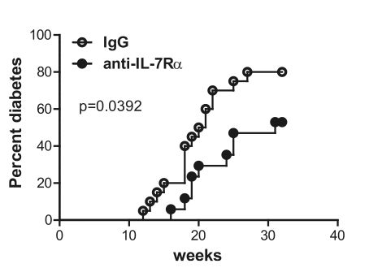
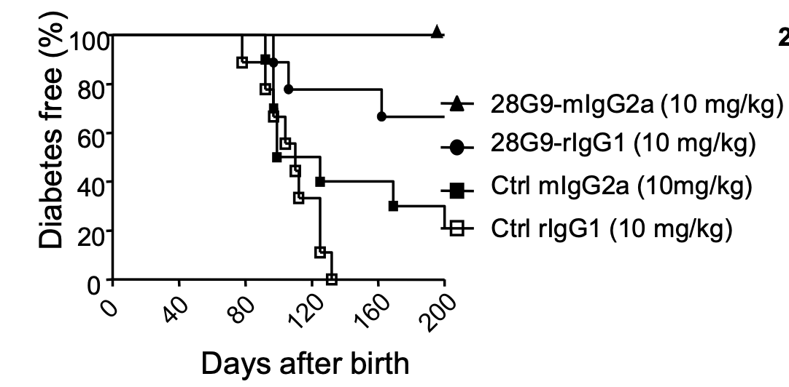
CD127 blockade extends diabetes-free intervals in NOD mice
Vazquez-Mateo et al. (2017)
BMC Immunology
(also saw increased TIM3 on T cells
in anti-IL7R mice)
Lee et al. (2012) PNAS
Penaranda et al. (2012) PNAS
Notes:
Left fig: top 2 are anti-IL7R Ab, NOD mice

Slide 28
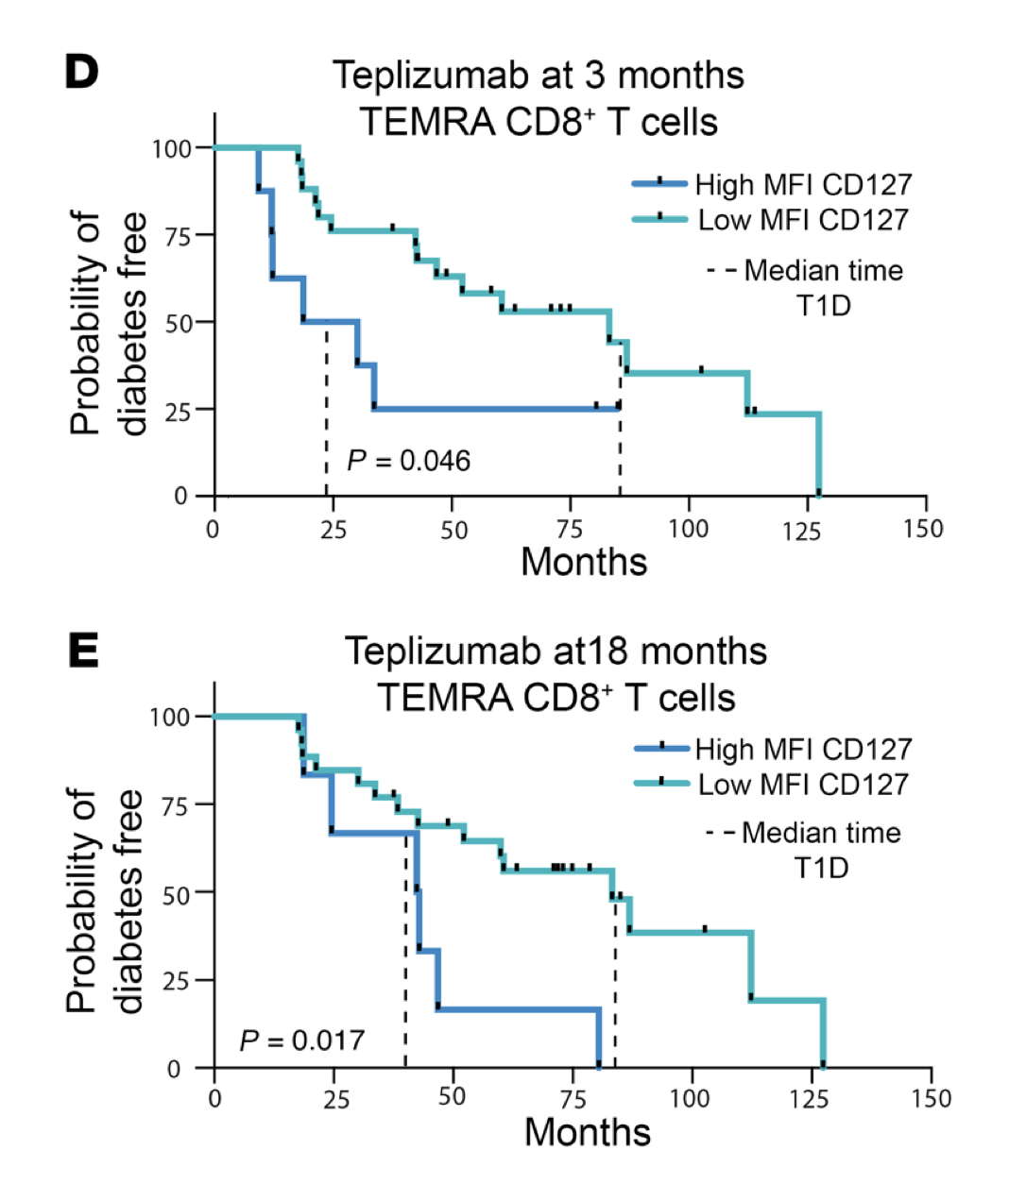
CD127 levels in CD8 TEMRAs predict response to teplizumab
Lledó-Delgado et al. (2024). J Clin Invest
Notes:
AbATE is recent onset, and TN10 is 14 day course of teplizumab to see if it would delay/prevent stage 3 T1D (clinical diagnosis) in those with high-risk (stage 2 T1D)
Higher levels of (partial) T_{ex} (TIGIT⁺ KLRG1⁺) CD8s associated with
slower progression to T1D
beneficial response to therapy (teplizumab/alefacept) and in at risk for and new onset T1D
Phenotype of islet-reactive CD8s is more so T_{eff}, less so T_{ex}

Slide 29
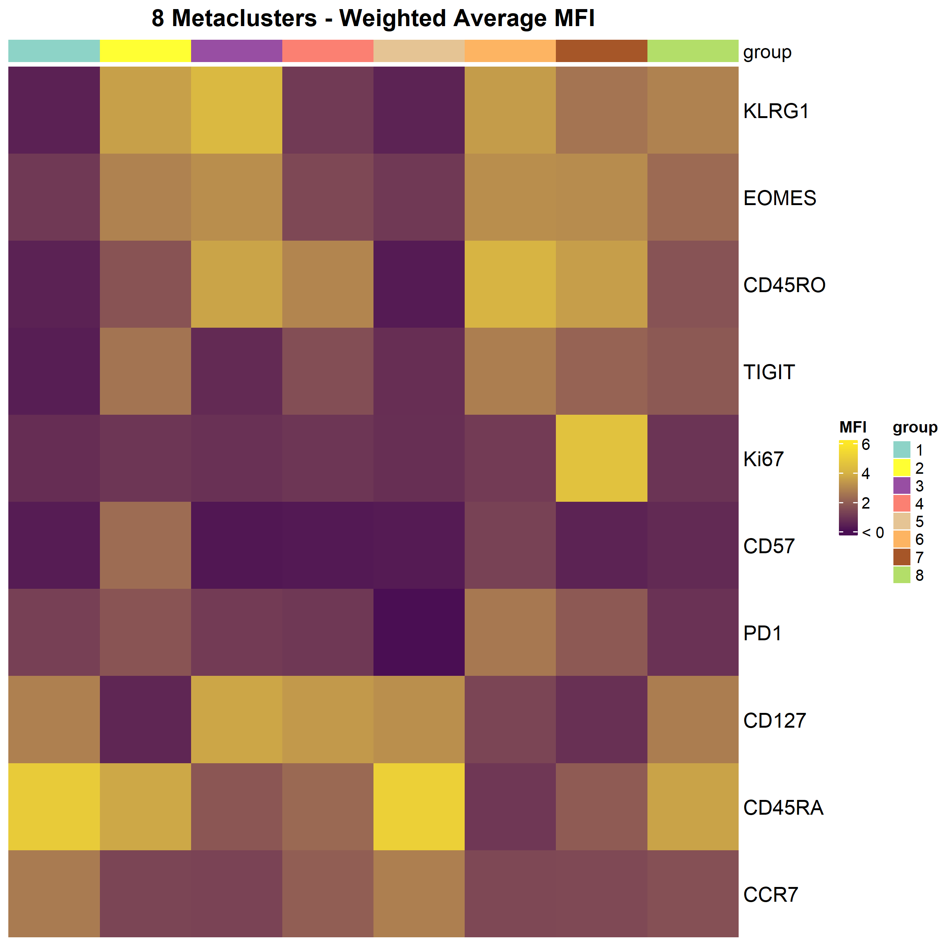
TN10 clustering analyses
CD127+ EM (T+K-)
CD127+ T-K+
CD57 Temra
PD1+ T+K+
T+K+ Temra
Naïve
Naïve
Ki67
1
2
3
4
5
6
7
8
p-value
0.9939
0.3253
0.0919
0.0288
0.7698
0.4169
0.2278
0.2945
p-value
0.8662
0.2399
0.0066
0.3737
0.2109
0.3382
0.0082
0.2214
p-value
0.9048
0.5974
0.0960
0.0584
0.8513
0.5740
0.1591
0.6373
dotted line represents p=0.05
p-value from comparison of upper to lower 3 quartiles
Negative designates upper quartile correlating with worse outcome
Joshua Centore

Slide 30
Obtaining consensus peaks to serve as features in counts matrix
Pile up reads from all alignment .bam files by study group (cell sort + responder status)
Find genomic regions (~1 kb) enriched in merged alignment files (call peaks)
Take union of these peaks

Slide 31
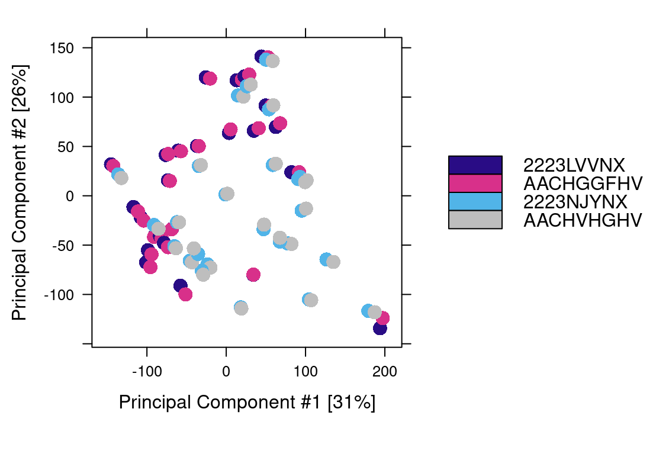
Epigenetics look very similar across sequencing batches
Flow cell ID: AA_ (original) and 22_ (resequencing)
Notes:
(AA_ fcids vs. 22_ flow cell IDs)
- so I merged alignment files by libid and then called peaks on those merged alignment files

Slide 32
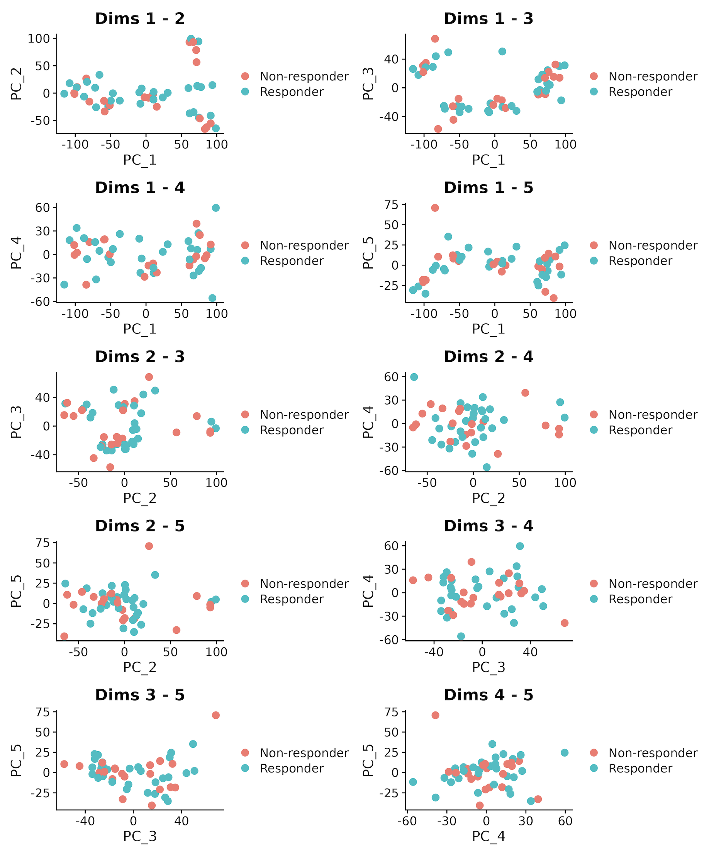
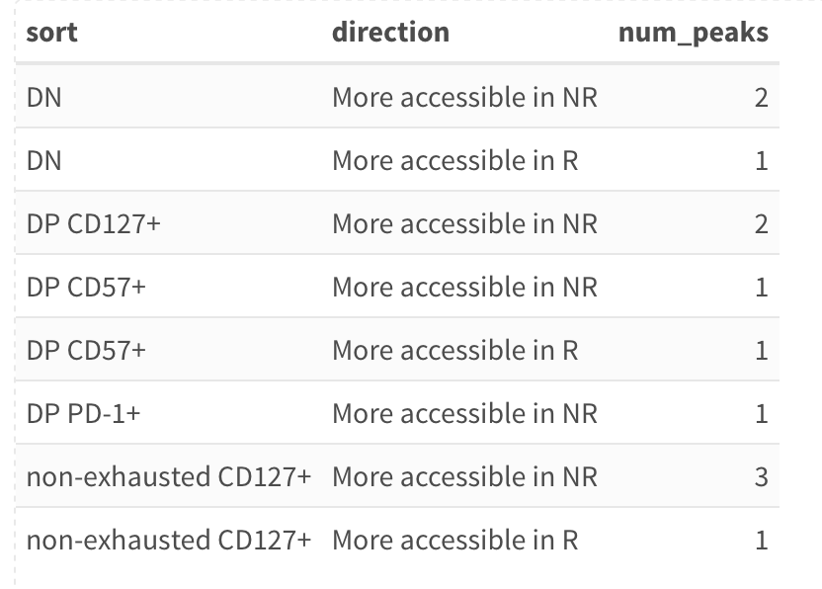
Epigenetic profiles of non-naïve CD8s from responders and non-responders to teplizumab are not clearly distinct
Notes:
teplizumab: 1st FDA approved drug to delay T1D (up to ~2 yr delay), humanized anti-CD3 monoclonal Ab to delay onset of stage 3 T1D in people with stage 2 T1D. mechanism: weak agonist of TCR-CD3 to induce anergy/apoptosis of T cells (i.e. autoreactive Teffs I presume), temporarily induces shift of T cells from periphery to elsewhere (lymph node or bone marrow perhaps) and then when T cells return to periphery in ~1 month it's less effector memory/TEMRA that return so it looks like increased Tex % of total CD8s

Slide 33
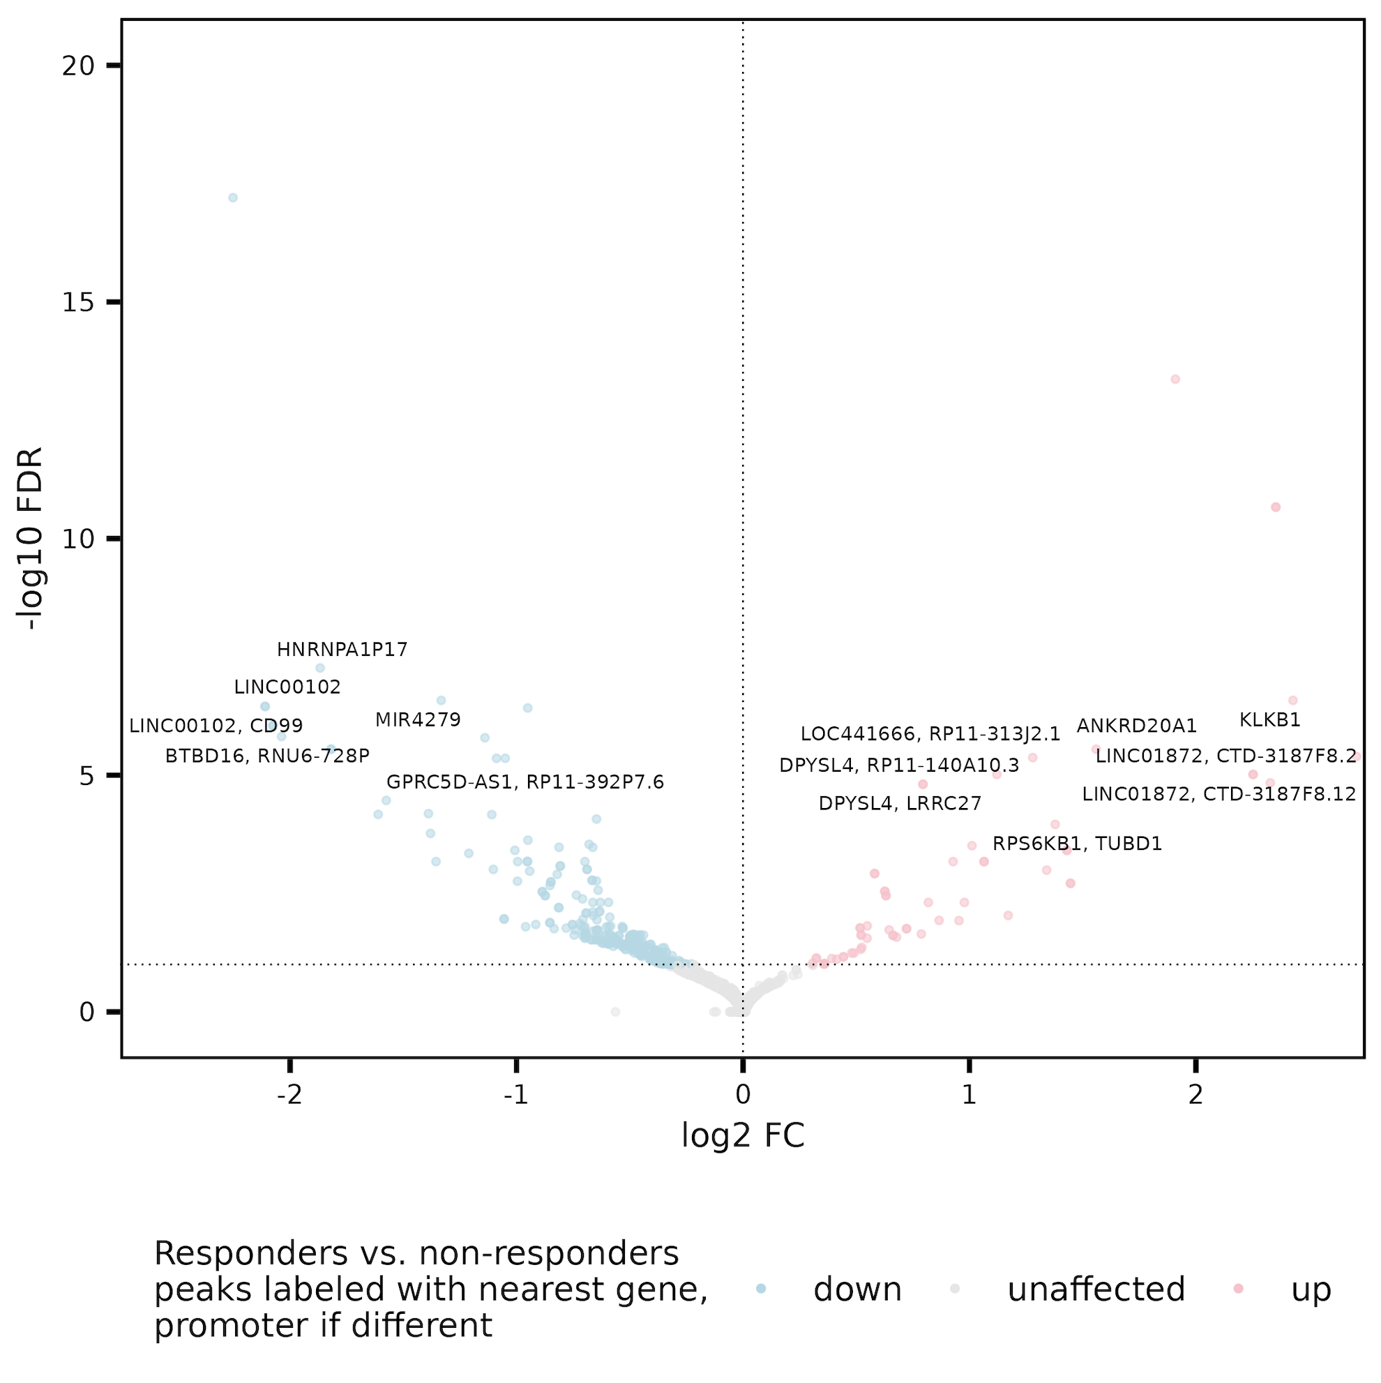
Obtain some DARs between R and NR looking across all cell sorts
potentially interesting hits
DPYSL4 associated with T1D progression
BTBD16 nearby the 10q26.13 T1D susceptibility locus
Notes:
Plot/analysis made with new covariate regressing out code
Adjusted for donor and responder status effects when comparing cell sorts (no big changes) and donor and sort effects when comparing R vs. NR

Slide 34
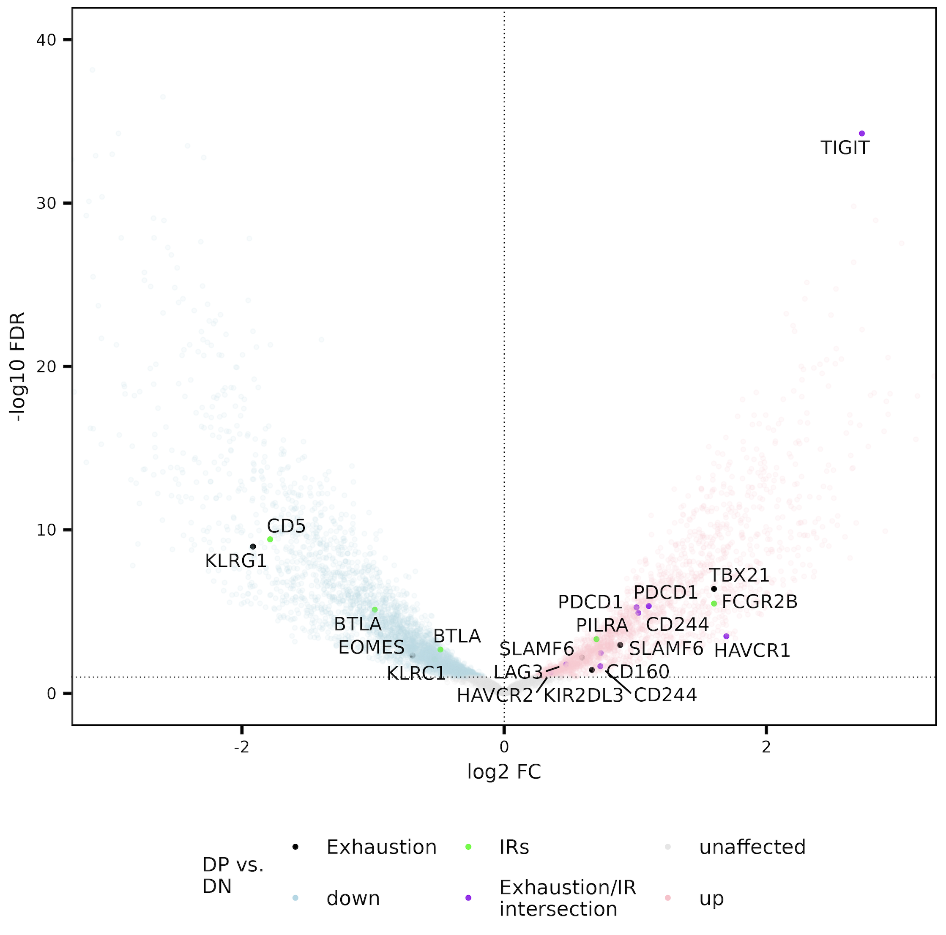
Sanity check: DP non-naïve CD8s do show signs of exhaustion
Notes:
Exhaustion up in DP (as expected)
PD1 vs. DN/NAND is marginally significant here for exhaustion I believe
ir_genes [1] "PDCD1" "HAVCR2" "PD1" "CTLA4" "LAG3" "TIM3" "TIGIT" "2B4" "CD160" "BTLA" "CD233" "CD244" [13] "FCGR2B" "PILRA" "FDF03" "CD72" "CD5" "PECAM1" "CD31" "CD22" "CEACAM1" "CD66A" "CD33" "Siglec3" [25] "LAIR1" "KLRC1" "NKG2A" "KIR2DL1" "HAVCR1" "KIR2DL5”
exhaustion_genes <- c("CD244", "SLAMF6", "TBX21", "PDCD1", "HAVCR2", "KLRG1", "TOX", "TCF1", "TCF7", "PD1", "CTLA4", "LAG3", "TIM3", "TIGIT", "KIR3DL2", "KIR2DL3", "NKG2A", "EOMES", "HAVCR1", "CD160", "BATF", "ICOS", "NR4A2”, “HEXB”)
HEXB added because of this paper: https://www.ncbi.nlm.nih.gov/pmc/articles/PMC11315911/

Slide 35
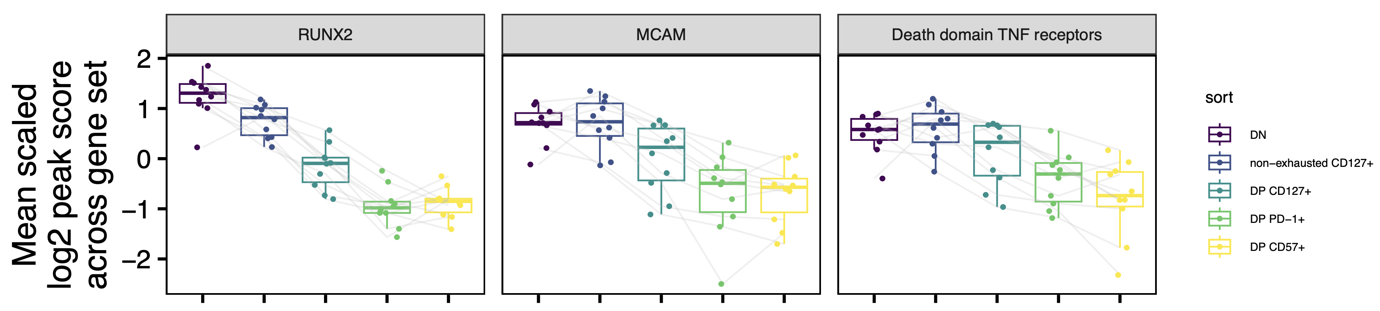
Other potentially interesting hits less accessible in more terminal sorts
Runx2 OE counteracts exhaustion in CD8s (Degolier et al. (2023) Blood)
MCAM proinflammatory, higher in autoimmunity (Dagur & McCoy (2015) Autoimmun Rev)
Notes:
Runx2 regulon shows no accessibility differences, so not as interesting, but Runx2 does apparently counteract exhaustion…
TNFR1/TNFRSF1A, Fas/CD95/TNFRSF6, DR3/TNFRSF25, TRAIL receptor 1/TNFRSF10A, TRAIL receptor 2/TNFRSF10B, DR6/TNFRSF1 and EDAR
Perhaps consistent with more naïve to more terminal, but not sure if it says anything more… (Fas/CD95 not in peaks I don’t think)
Don’t see this looking at all TNF receptors… so thinking this is perhaps spurious

Slide 36
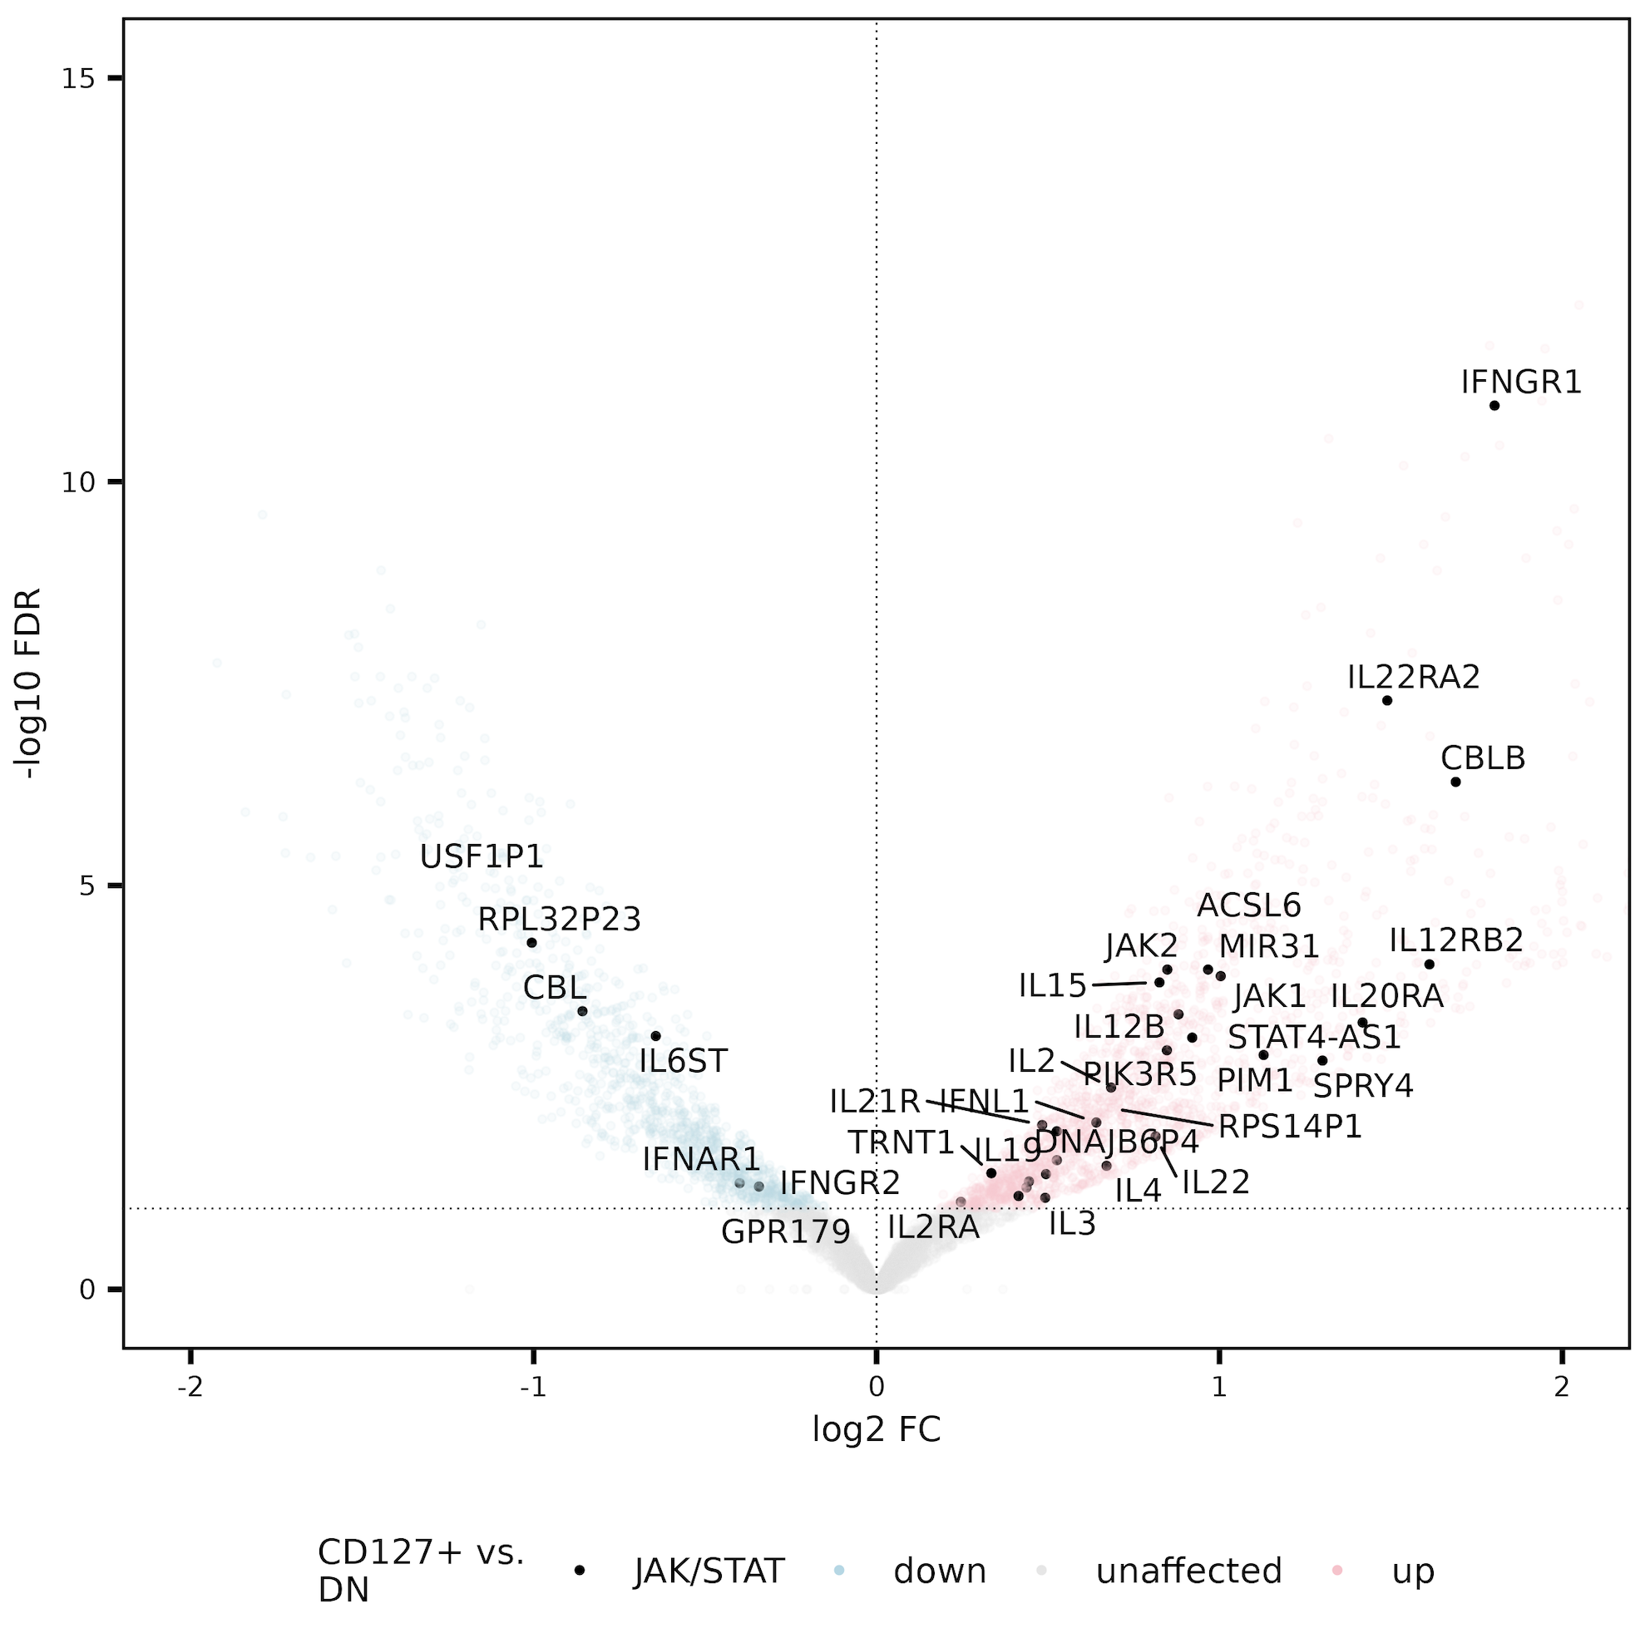
Peaks more accessible in CD127⁺s than DNs are enriched for JAK/STAT gene set
Notes:
JAK/STAT enriched (stringdb) in peaks’ genes/promoters up in both CD127⁺ sorts vs. DN
JAK/STAT may negatively associate with Tex (JAK inhibitor induces Tex)

Slide 37
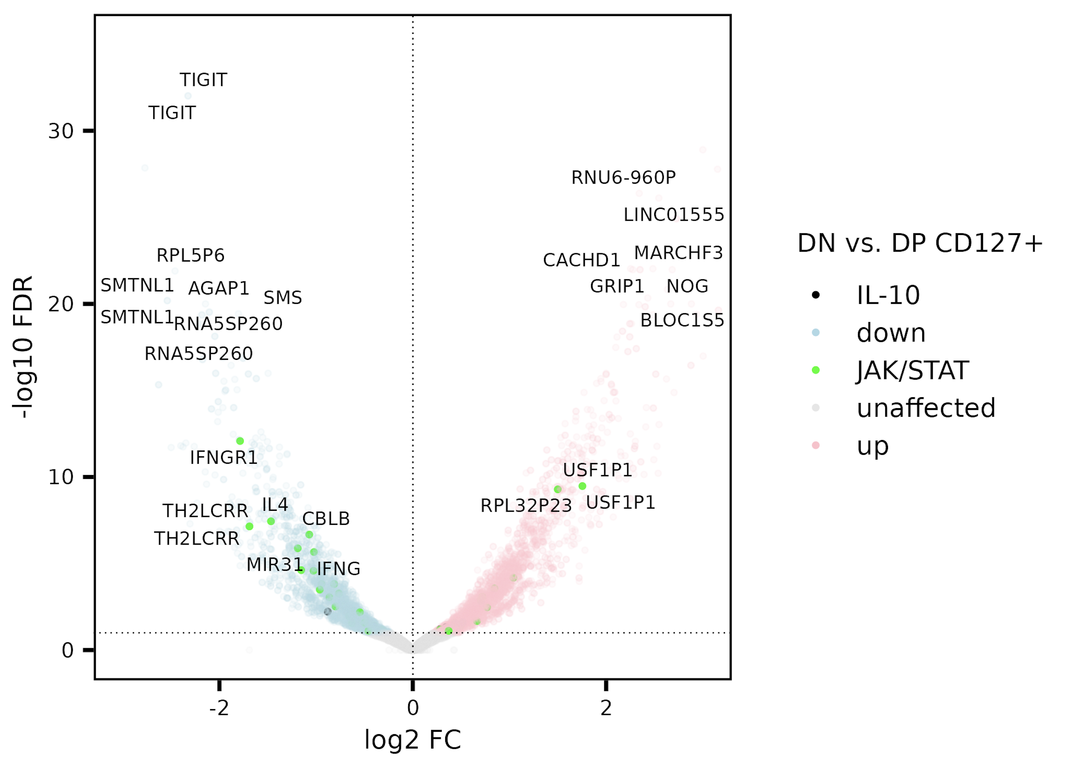
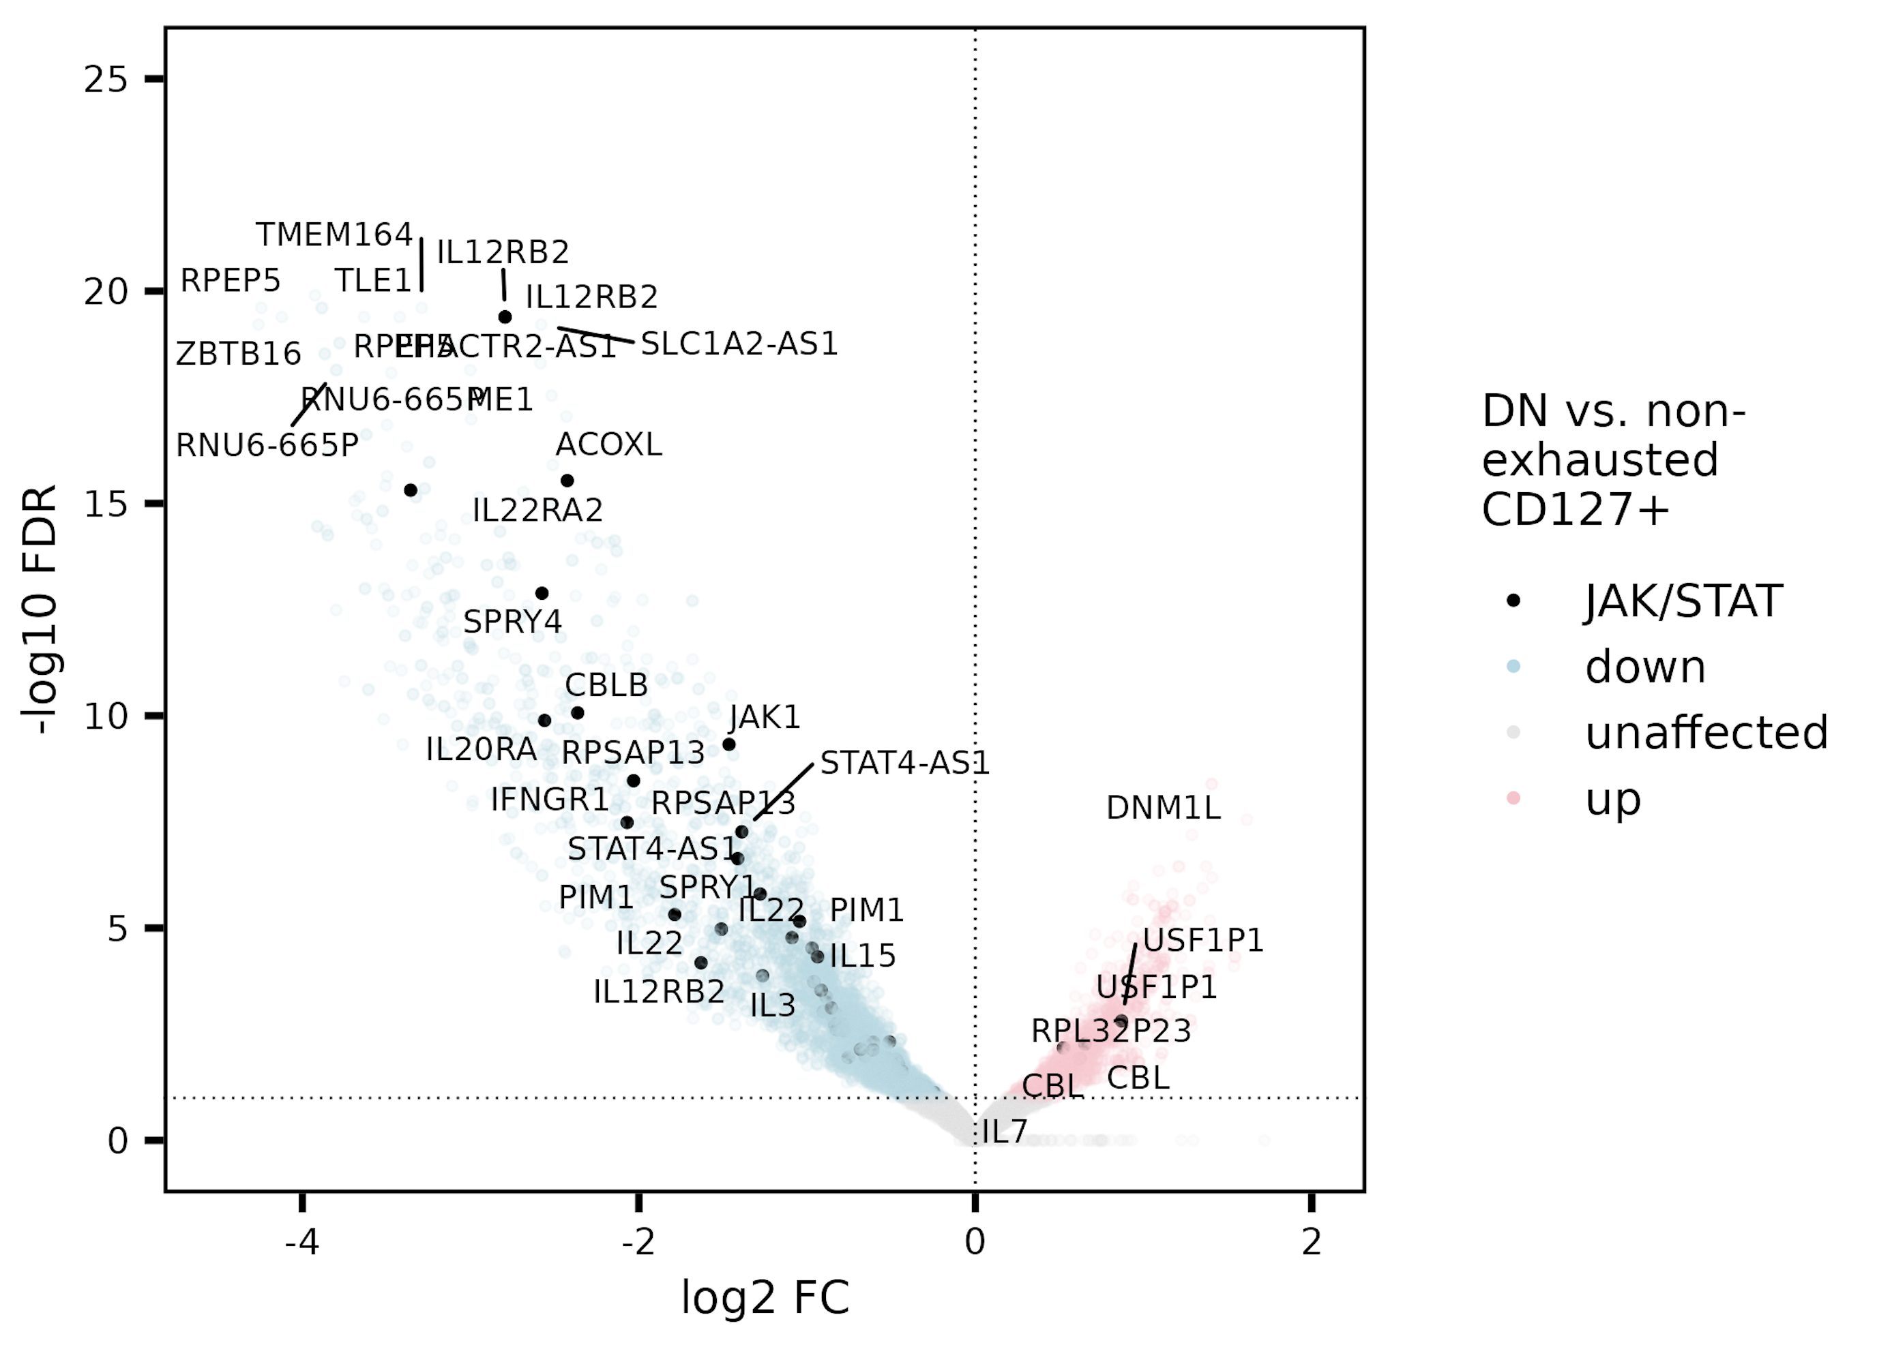
Peaks more accessible in both CD127⁺ sorts vs. DN perhaps enriched for JAK/STAT gene set
JAK/STAT & IL-10 enriched (stringdb) in peaks’ genes/promoters up in both CD127⁺ sorts vs. DN

Slide 38
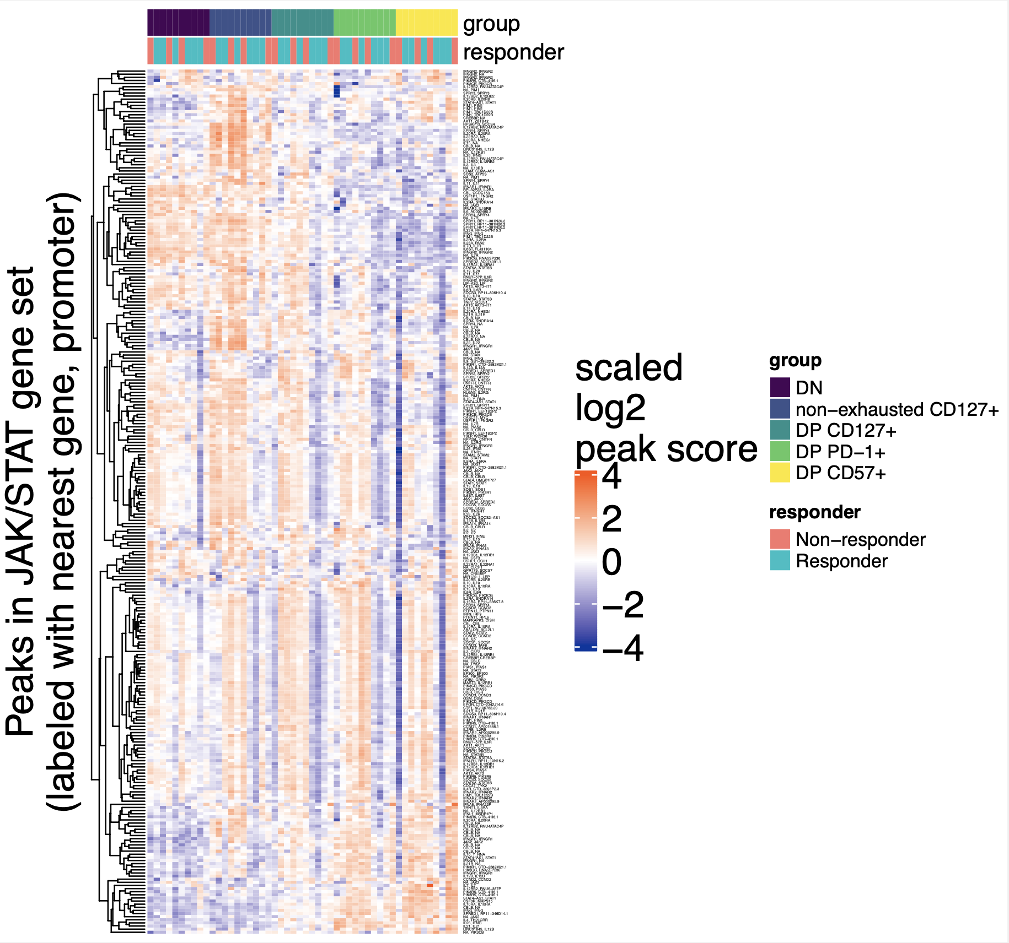
However, looking at mean accessibility of all peaks near JAK/STAT genes, no longer observe (weak) CD127⁺ effect
Notes:
JAK/STAT enriched (stringdb) in peaks’ genes/promoters up in both CD127⁺ sorts vs. DN
JAK/STAT may negatively associate with Tex (JAK inhibitor induces Tex)

Slide 39
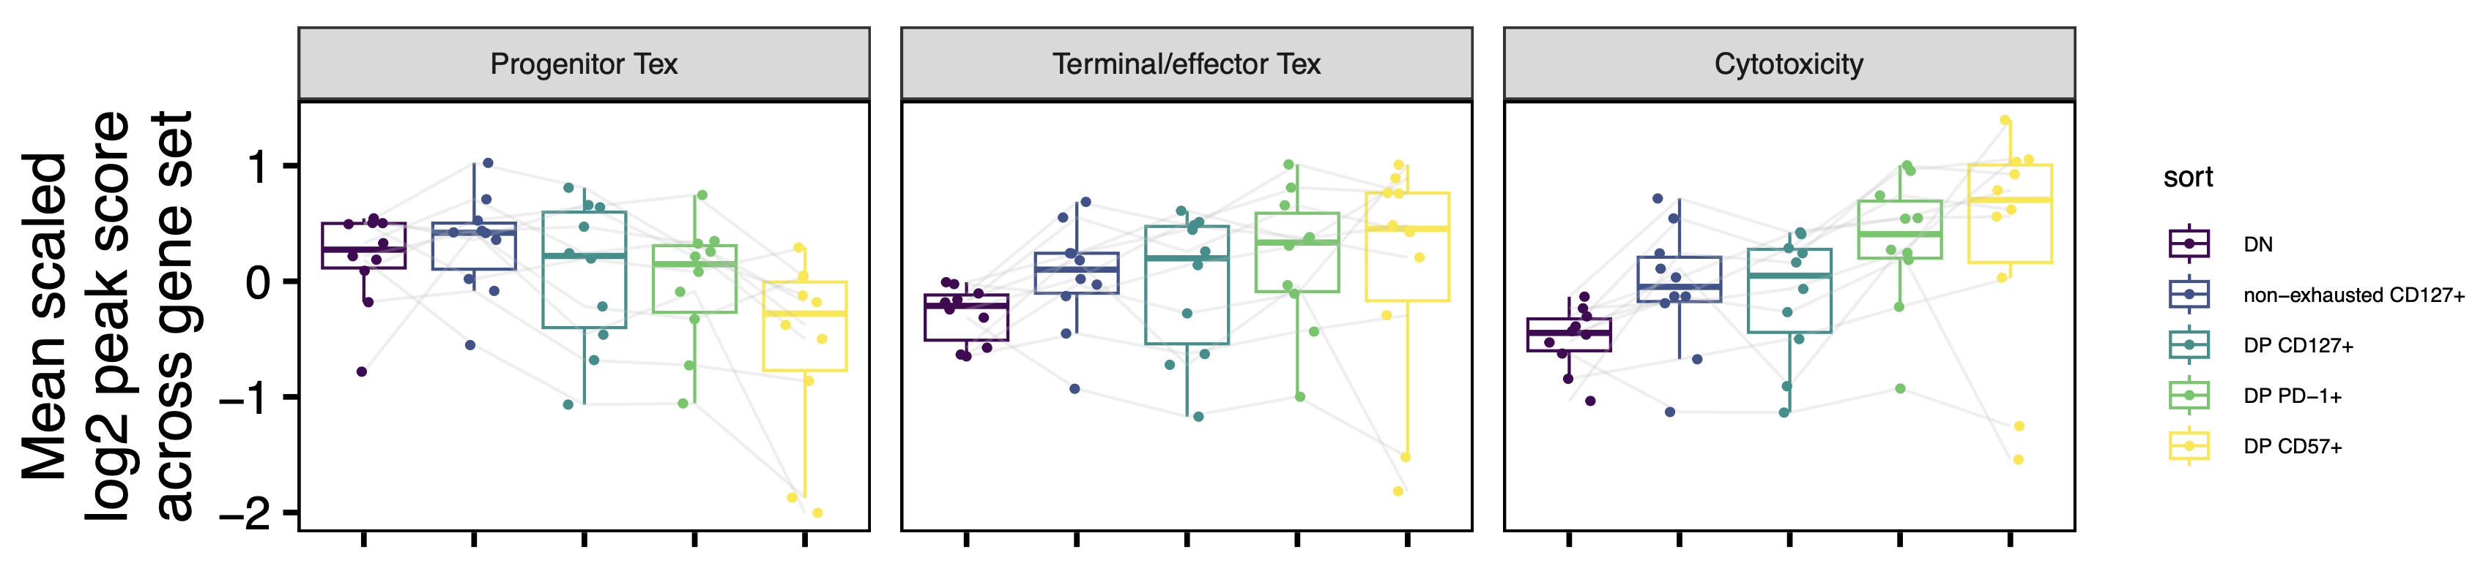
Mean gene set views of T_{ex}, cytotoxicity genes
Notes:
cytotoxicity_genes [1] "GZMA" "GZMB" "GZMH" "GZMM" "GZMK" "PRF1" "NCR1" "KLRF1" "NKG7" "IFNG
terminal_genes [1] "CD38" "ID2" "PRF1" "IFNG" "PRDM1" "CX3CR1" "CD101" "TOX" "CD39" "HAVCR2" "CD244" "GZMB" "RUNX1" [14] "TIGIT" "PDCD1" "LAG3" "CD244" "ITGAE" "CTLA4" "EOMES" "TBX21" "ZEB2" "KLRG1" "CD69”

Slide 40
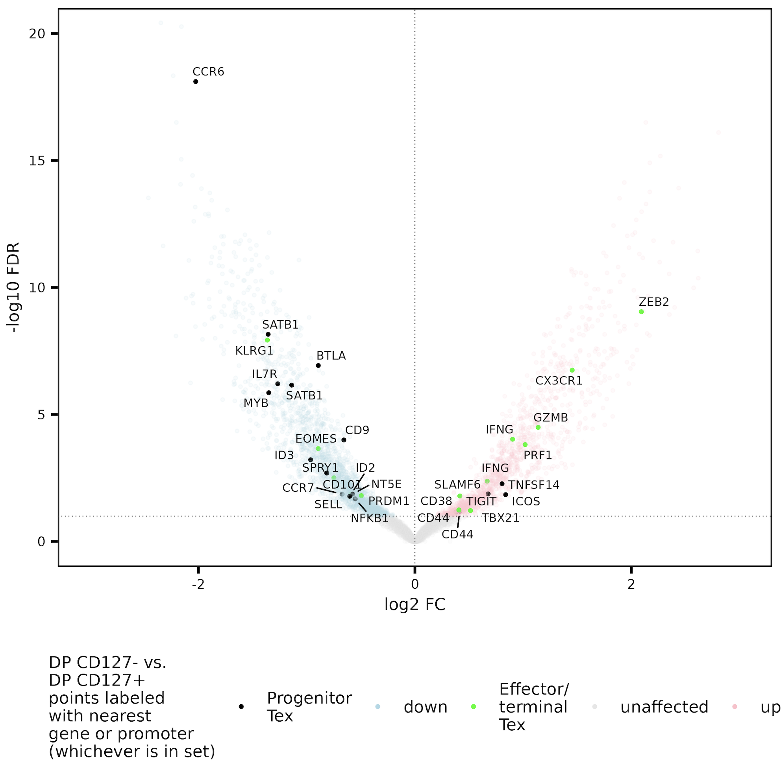
DP CD127⁺ lean to having more accessible peaks near progenitor T_{ex} genes, DP CD127⁻ lean more effector/terminal T_{ex}
Up in DP CD127⁺
Up in DP CD127⁻
Progenitor T_{ex} genes: TNF, IL7R, SPRY1, 5, CD73 (NT5E), CCR7, SELL, CD9, ICOS, TNFSF14, SATB1, CD44, SLAMF6, IL2, MYB, CD83, REL, NFKB1, FOXO1, BTLA, CCR6, CD81, CRTAM, TCF7, ID3
Effector/terminal T_{ex} genes: CX3CR1, ZEB2, CD38, PRF1, PRDM1, GZMB, ID2, IFNG, CD101, ENTPD1 (CD39), HAVCR2 (TIM-3), CD244, RUNX1, TIGIT, PDCD1, LAG3, CD244, CD103, CTLA4, EOMES, TBX21, CD69, KLRG1, TOX
Bold meaning consistent evidence in mean gene coverage plots (CD38, PRF1, PRDM1, GZMB higher only in DP CD57⁺)
Notes:
Some of the terminal consistent evidence mean coverage plots are really just higher in DP CD57+ and similar in DP CD127+/PD-1+ (but this is consistent with DP CD57 being most terminal given the MT SNV counts), haven’t yet looked at this VP coloring in each DP CD127+ vs. PD-1/CD57 separately as I have done for the purine metabolism/TGFB gene sets
Likely that not all of these chosen genes are equally selective for progenitor vs. terminal… list could definitely use revision/immunologist perspective
NT5E = CD73, SELL = CD62L
Texeff: TBX21/Tbet, Zeb2, KLRG1
ITGAE = CD103, TBX21 = TBET

Slide 41
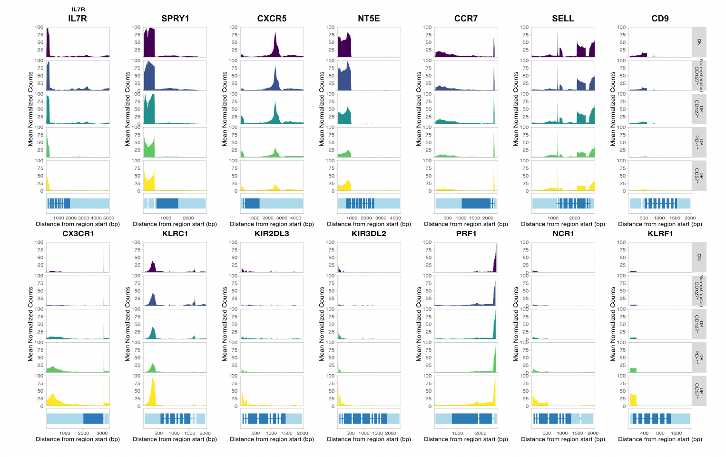
DP T_{ex} heterogeneity also observed in gene bodies

Slide 42
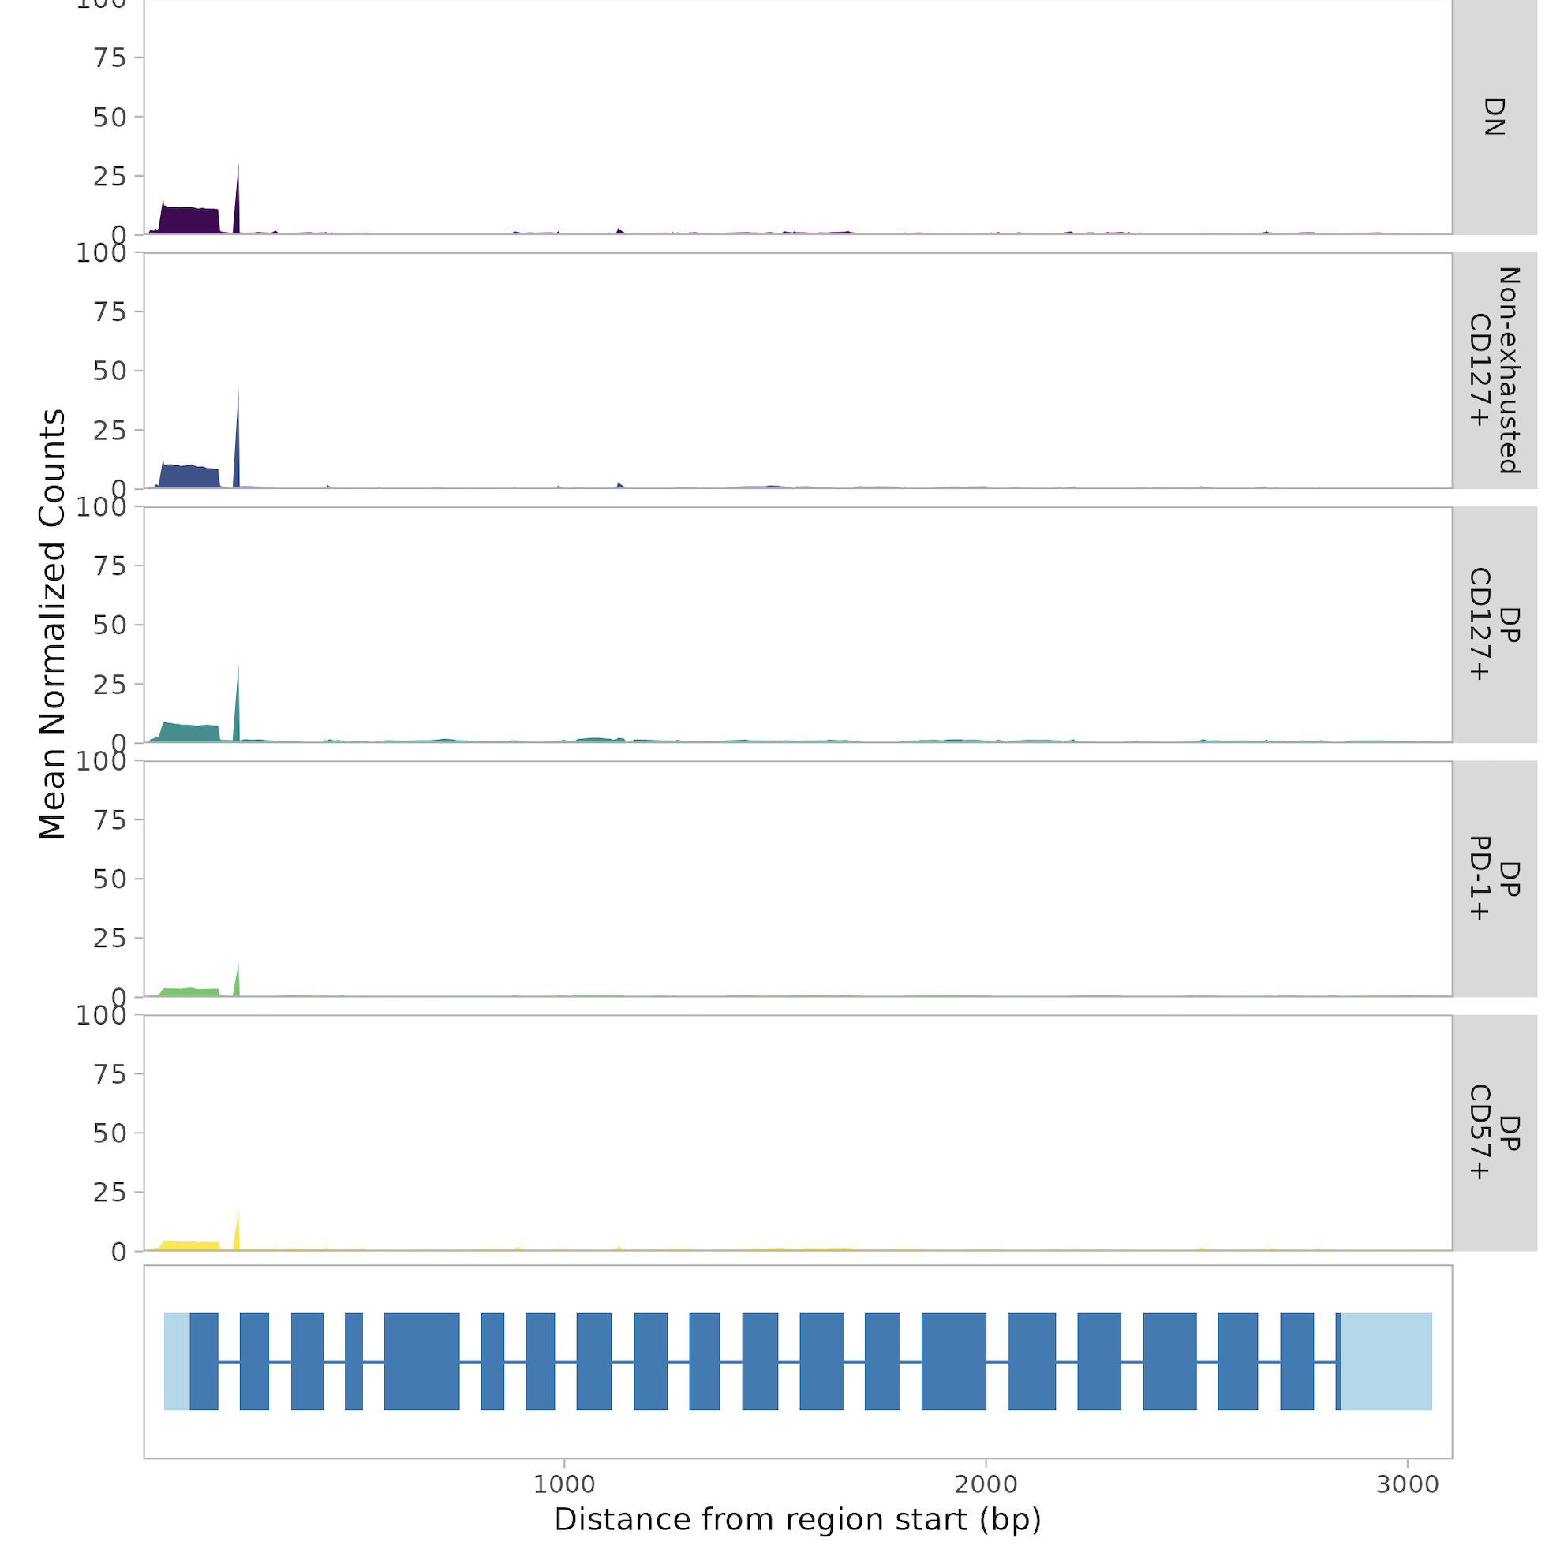
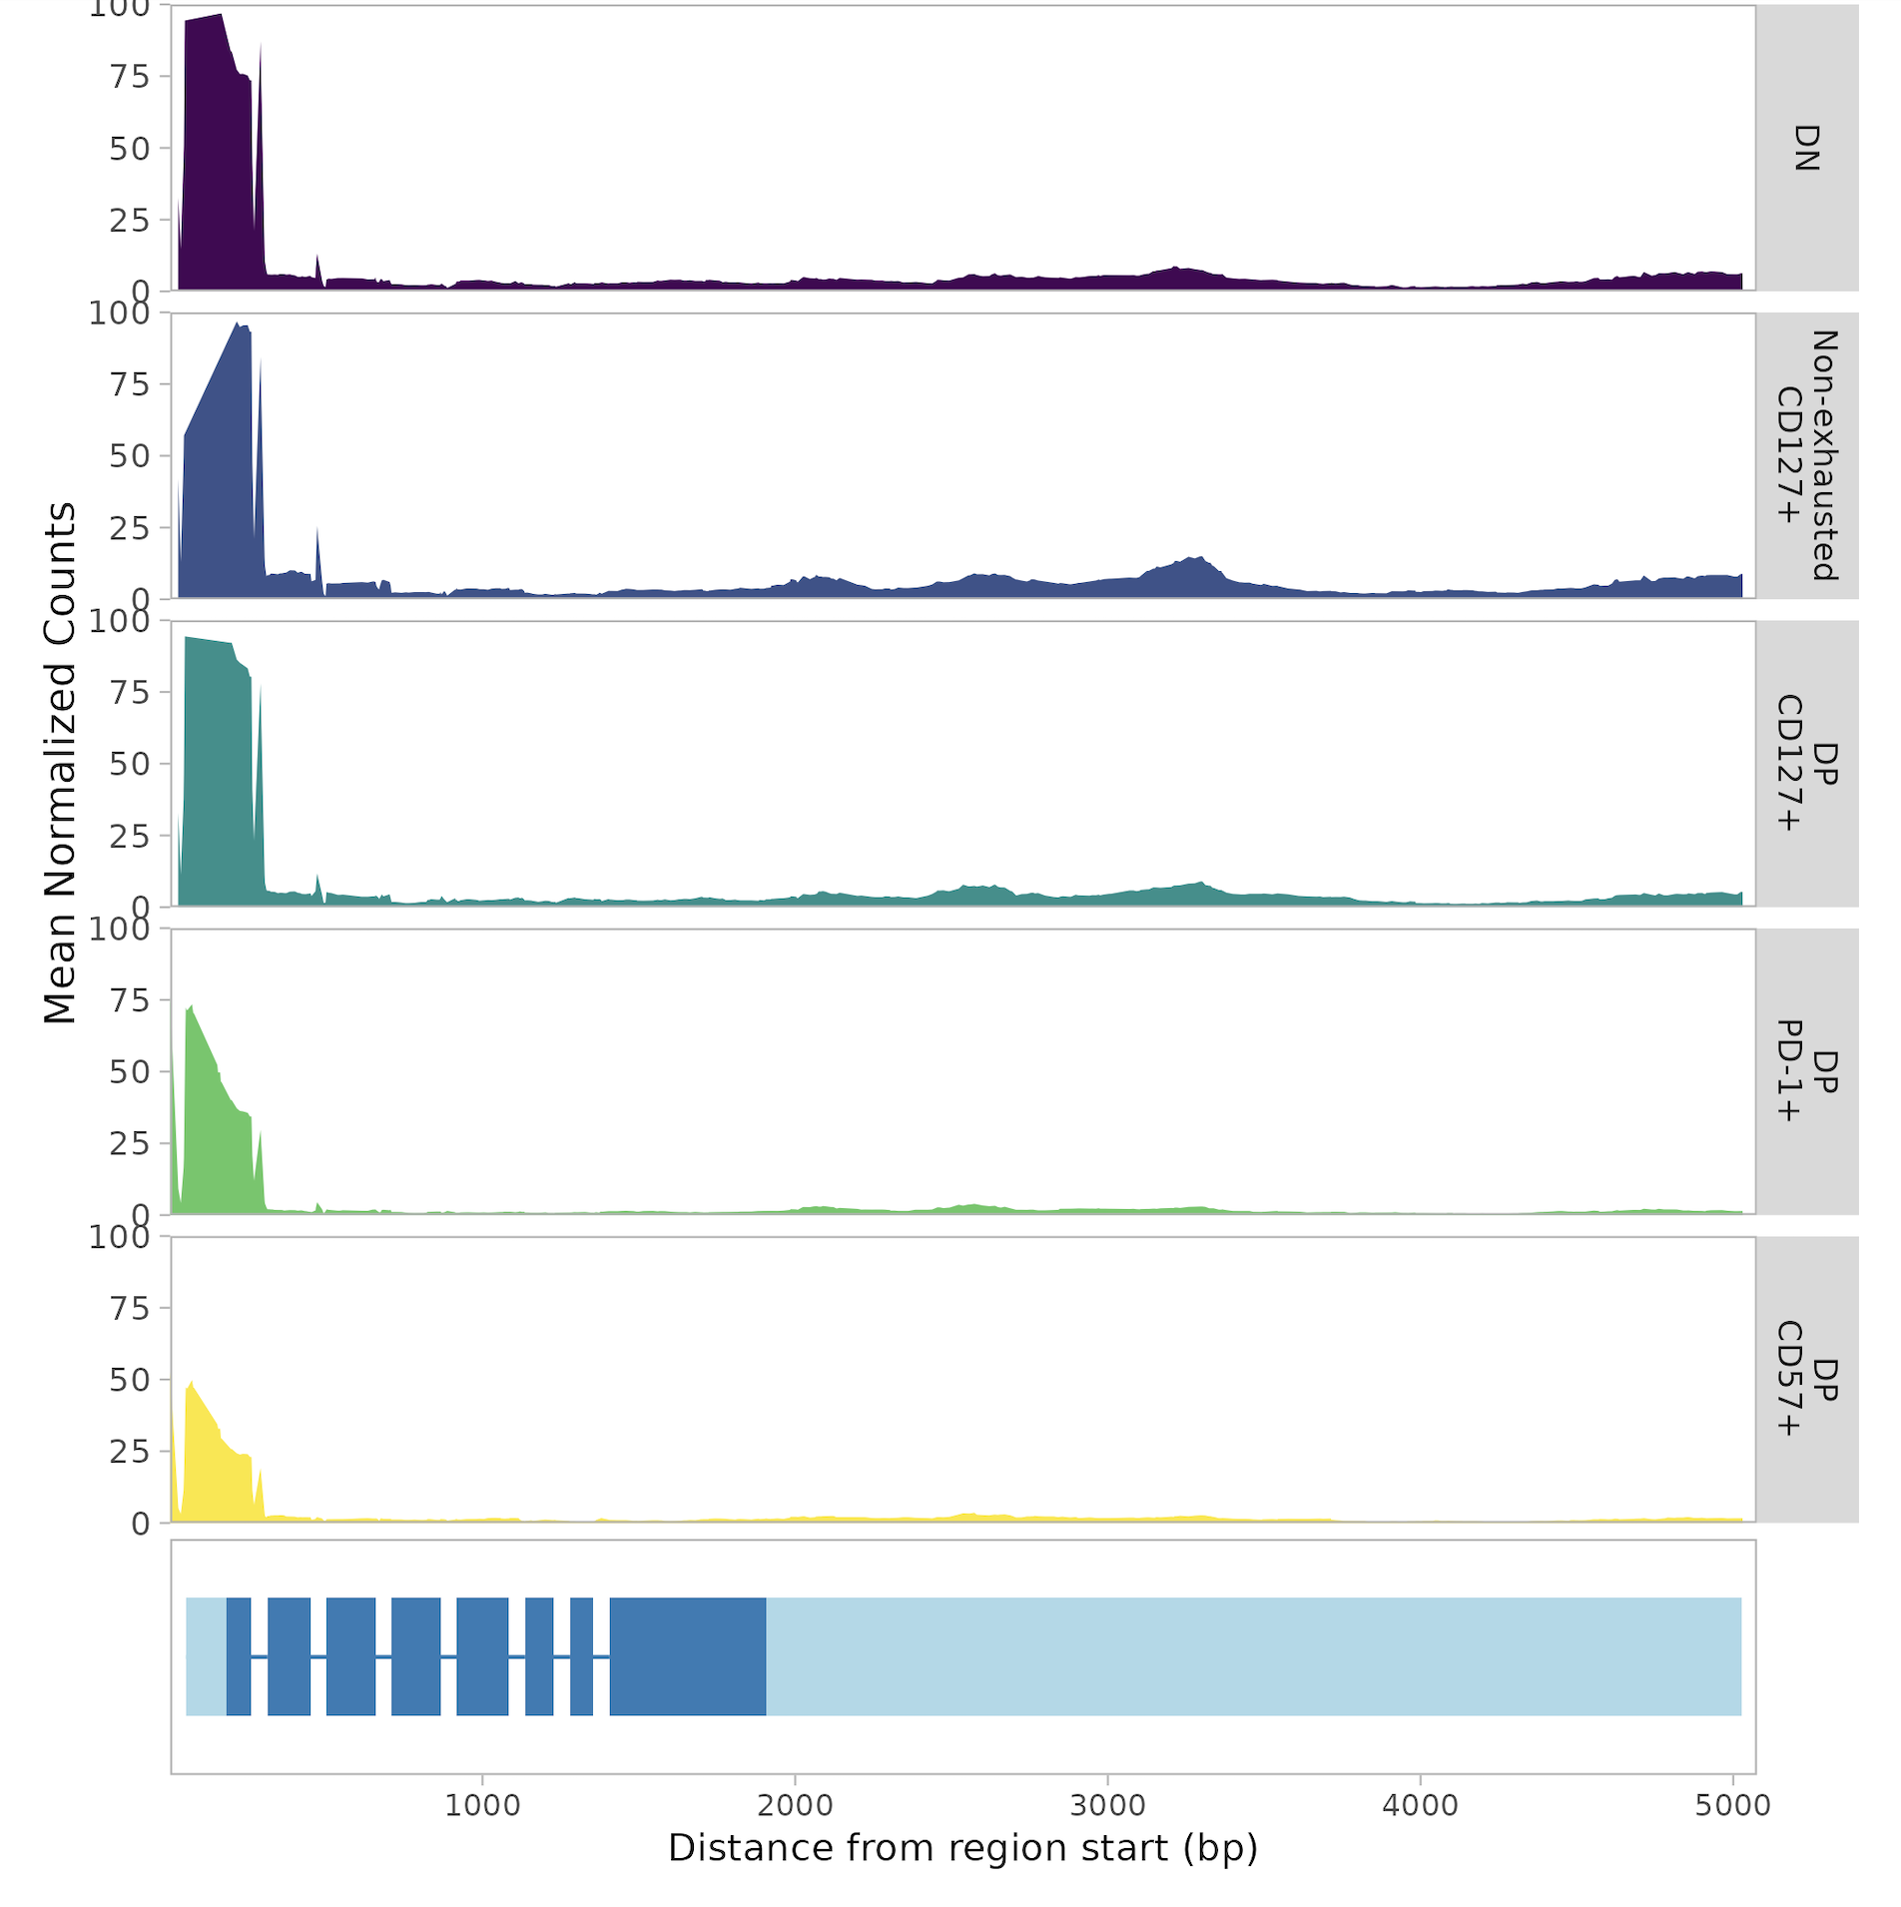
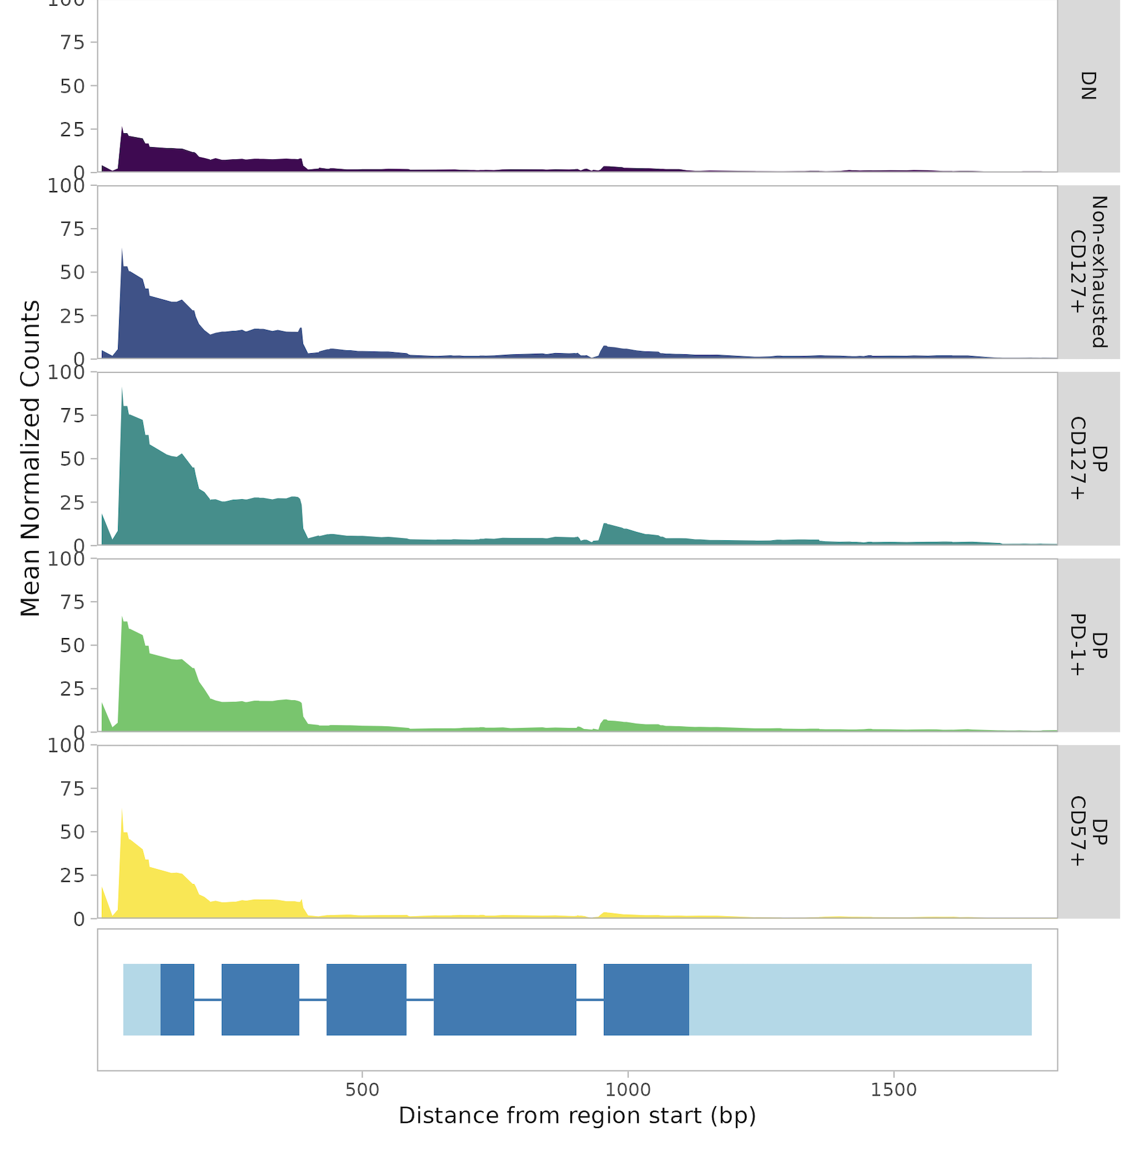


Genes with higher coverage in DP CD127⁺ or lower coverage in DP CD127⁻
PDE9A (purine)
IL7R
GZMK
SPTBN1 (TGFβ)
MDS2 (purine)

Slide 43


Peaks more accessible in DP CD127⁺ than both DP CD127⁻ sorts enriched for purine metabolism gene set

Slide 44



Some purine metabolism genes more accessible in DP CD127⁺ than DP CD127⁻ CD8s
AK4 gene
NOG gene
Up in DP CD127⁺
Up in DP CD127⁻
Notes:
Also (less dramatically): PDE9A, MDS2
PDE7A shows opposite trend (high in DP CD127-)

Slide 45

Peaks more accessible in CD127⁺ vs. CD127⁻ also enriched for purine gene set

Slide 46

Enrichment of TF motifs in differentially accessible regions between DP CD127^{+/-} ~consistent with differentiation model
More progenitor
TCF7
TFDP1?
HOXB4?
More terminal
Tbet
IRF?
MGA?
HIF1A?

Slide 47

ROR TF motifs enriched in peaks more accessible in non-exhausted CD127⁺ than DP CD127⁺
Notes:
PAX5 haploinsufficiency induces CD8 T cell dysfunction/exhaustion (high IR expression) (Liang et al. (2021) Cancer Treatment and Research Communications), low tier journal but consistent with DP CD127+ more exhausted than NAND CD127+
Tbx2 enriched in intermediate Tex vs. progenitor/terminal Tex, doesn’t make much sense up in NAND… https://www.ncbi.nlm.nih.gov/pmc/articles/PMC8360766/

Slide 48





CTCF(L) TF motif enriched in peaks more accessible in DN vs. CD127⁺

Slide 49

Cover MT genome to ~685k X depth
Notes:
# mean across positions and libs is 13,697 reads covering a specific position per lib, so that's 50*13,697 = ~685k X depth or coverage
Got the same # doing sum(combined_coverage_data$coverage) / 16569 (MT genome size)
Got coverage values/position from samtools (samtools depth -r MT to specify MT genome)

Slide 50

Bimodal distribution of MT SNV frequencies
Notes:
Perhaps bimodal because variants quickly “dominate” once emerged, or related to bulk seq (i.e. only looking at most common non-ref var here…)
bimodal "issue" also present in T1DAL, and for both projects it seems like medium frequency vars are preferentially present in all sorts in a donor, so removed...

